Slide 1


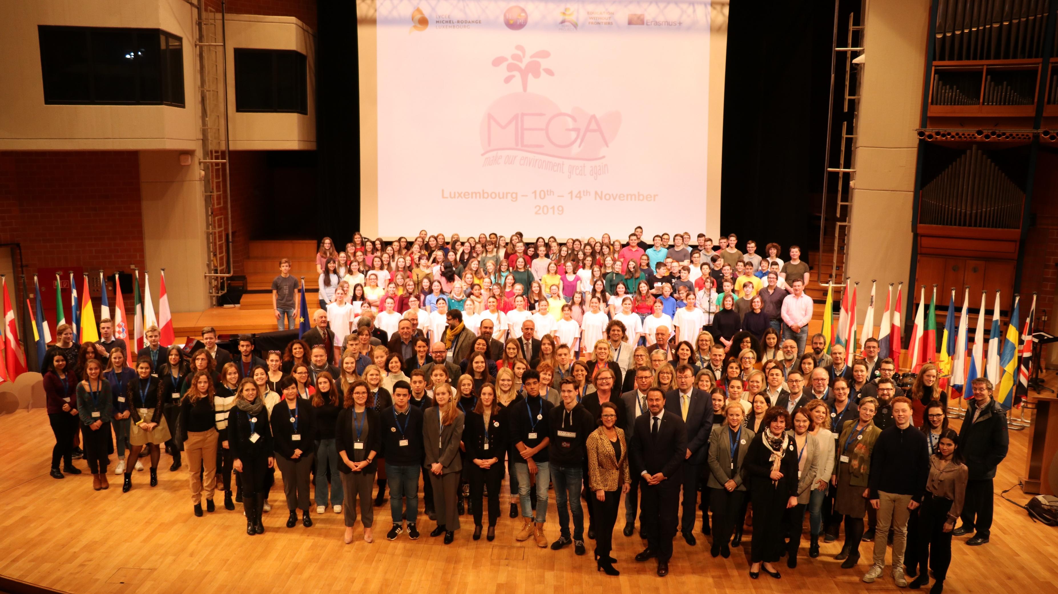



MEGA Projects 2020 - 2021
https://hopeclub.philosophia.lu/megalux

Slide 2

Participating Schools

Slide 3
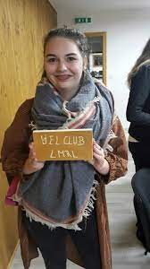
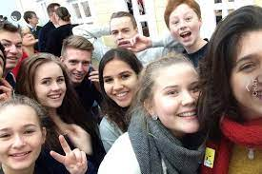
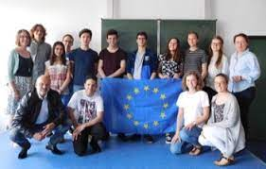
How to act? The power of students clubs
Weekly meetings
Voluntary participation
Age group: 15-19
Focus on the students’ ideas
Relaxed atmosphere
Teachers as coaches

Slide 4

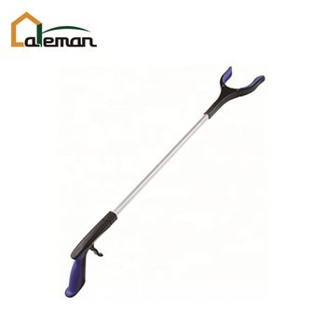
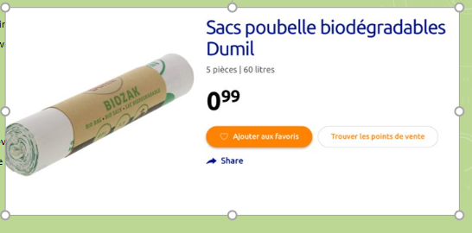
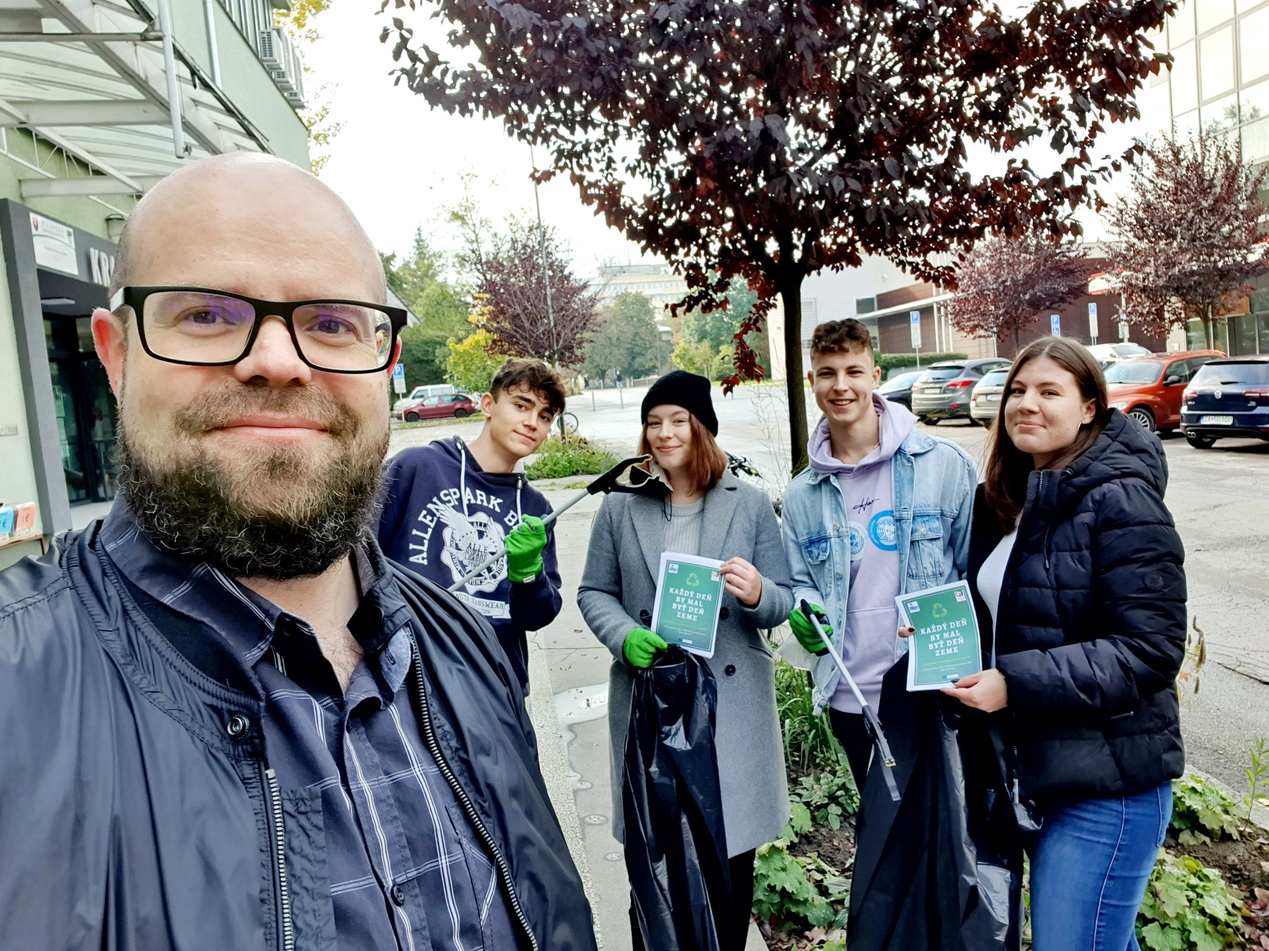
Project 1: Community Clean-up/”MEGA Walks”
What? collecting trash and evaluating results
Where? in & outside school campus (Merl Parc,…)
When? once a year
Who? the students/teachers that wish to contribute
How? we’d provide hygienic gloves, biodegradable bags (& trash grippers if needed)
Walks around our city, where we collected the trash from the streets
Goals:
better waste separation
adapt waste disposal bins at school
improve recycling methods and recycling options (also in new school building)
raise awareness and educate our school community

Slide 5
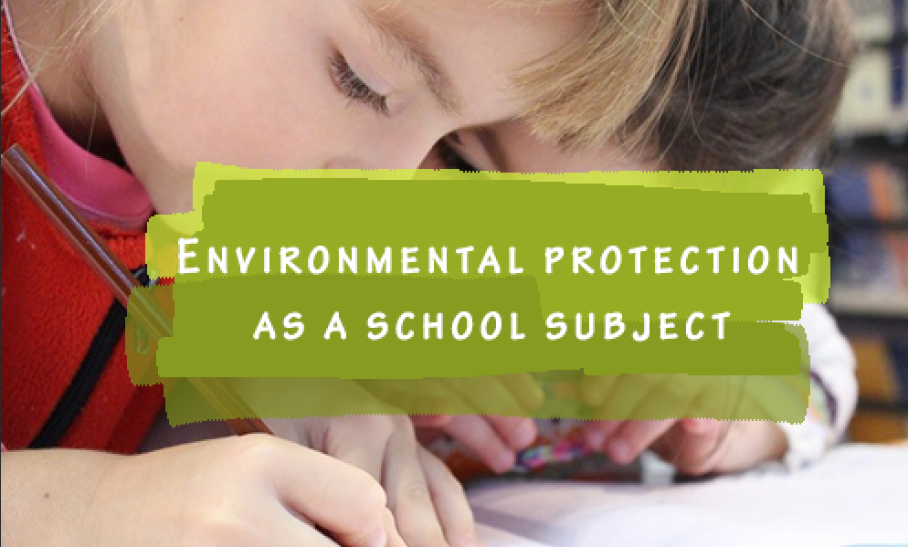
Project 2: Environmental lessons by students for students
Environment lessons from older students to younger students in different schools, peer-to-peer
Subject: Educating students on what they can do in practice to protect our environment
Single workshop over 2 hours (for example in the context of a tutoring lesson)
Involving experts:
  Biology & geography teachers + scientists

Slide 6



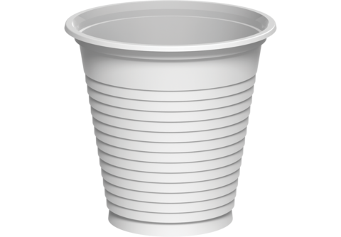
Project 3 – Coffee Culture
Getting rid of the plastic coffee-cups at the vending machine
Bring your own
Sell reusable cups

Slide 7
Project 4 – Meatless Monday
Poll results from the school community are largely in favour
Wéi motivéiert bass du fir selwer e Bäitrag zur Ëmwelt ze leeschten? (1 wéineg motivéiert – 5 vill motivéiert)
3,85 / 5
Fir wéi problematesch häls du den Impakt vun der Fleeschproduktion op d‘Ëmwelt? (1 wéineg problematesch – 5 immens problematesch)
3,63 / 5

Slide 8
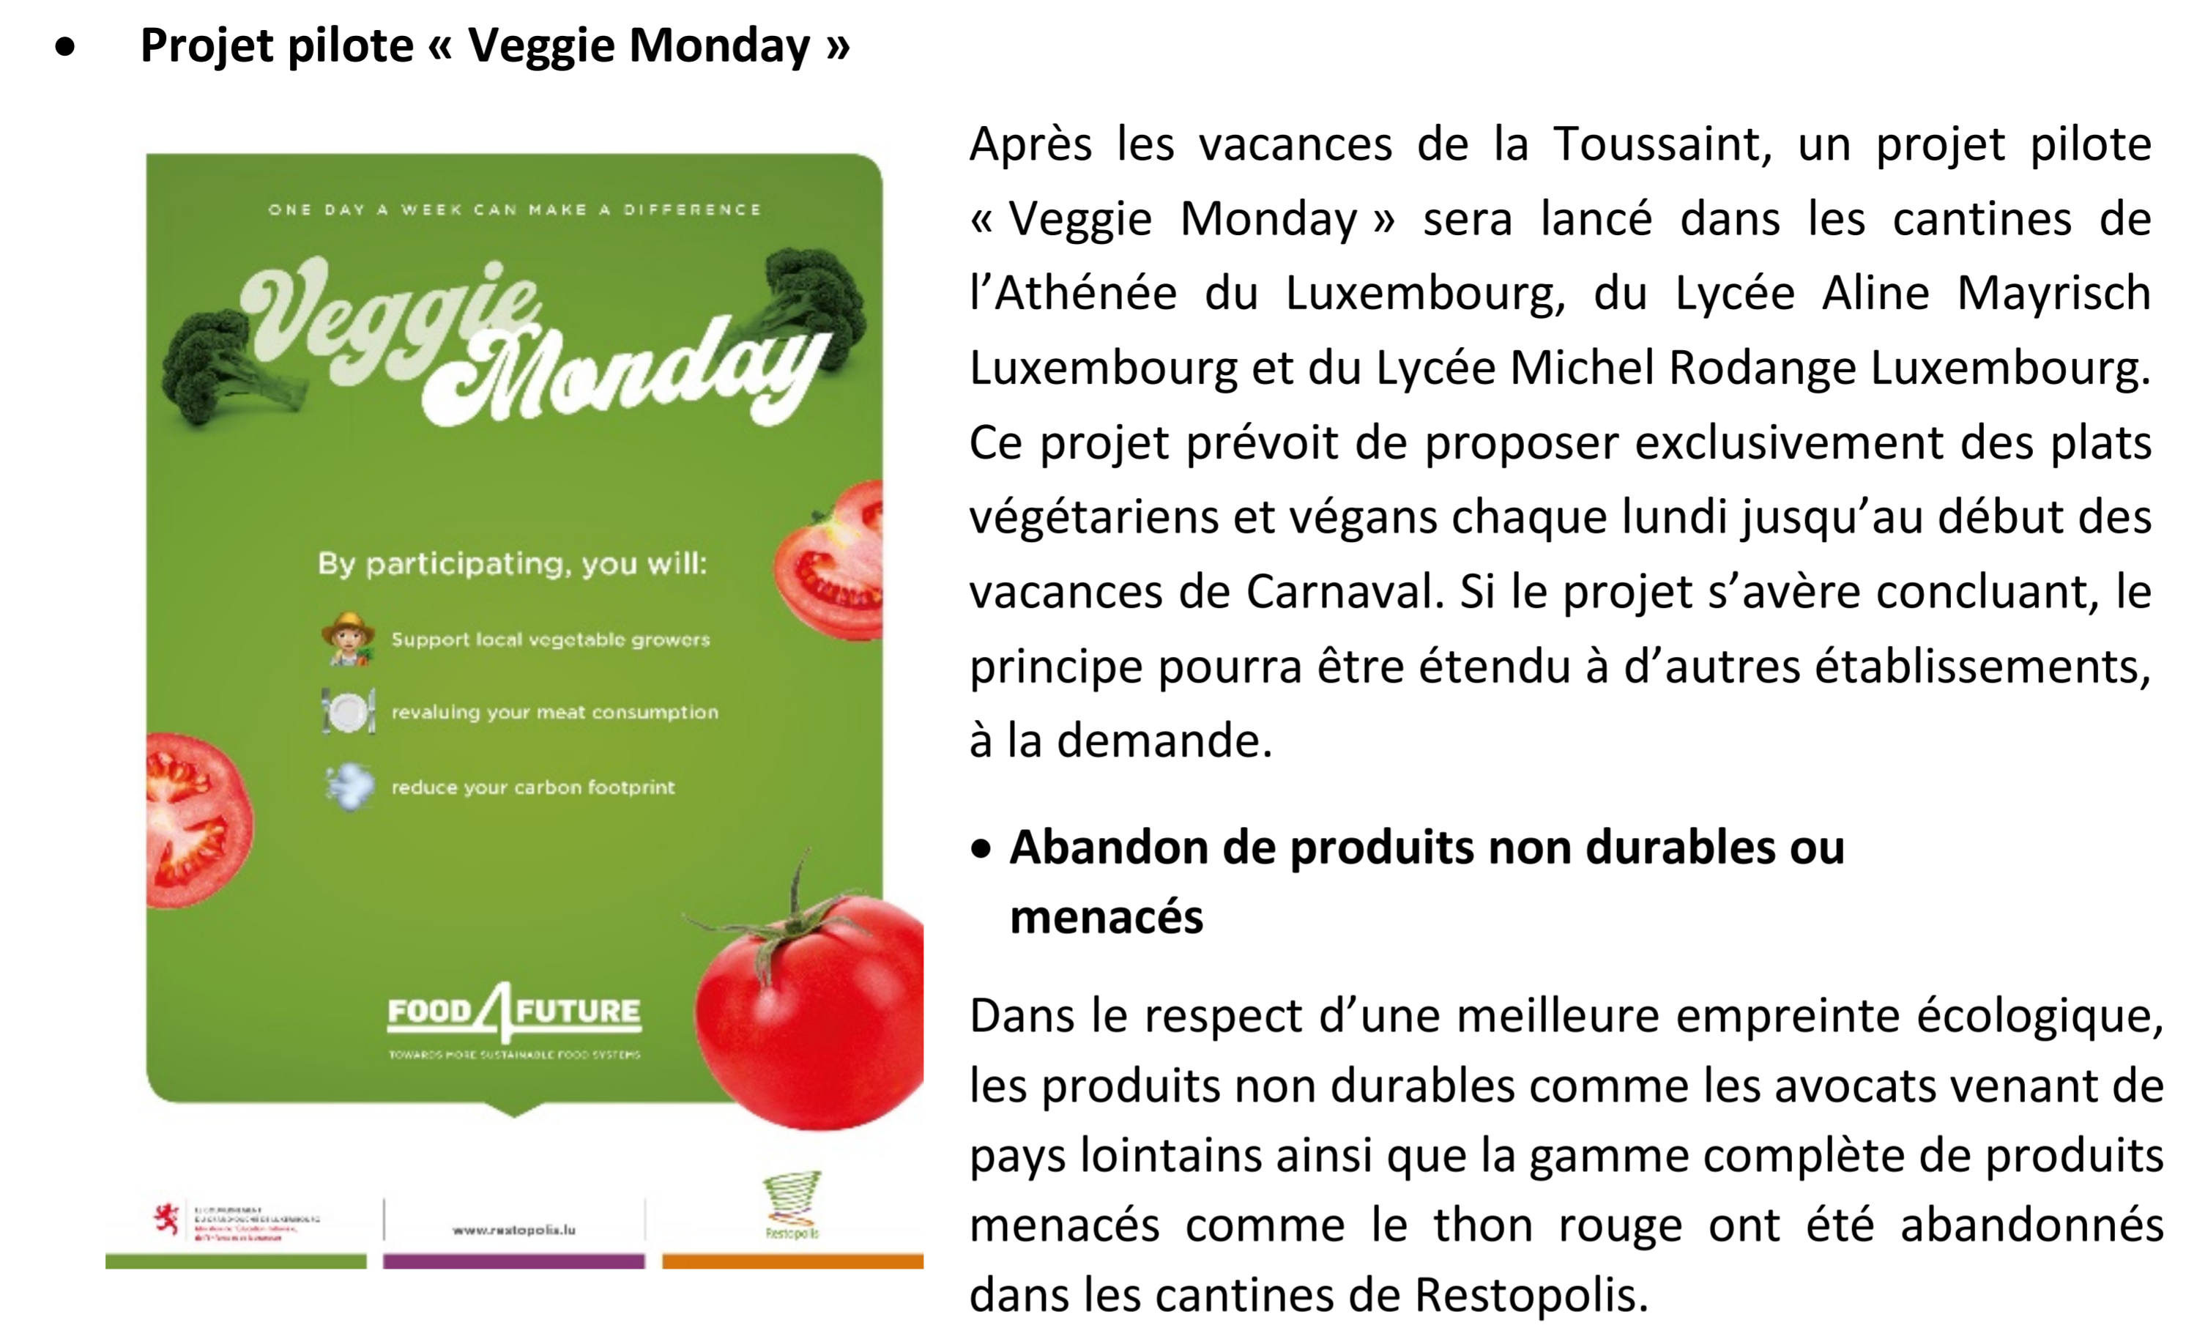
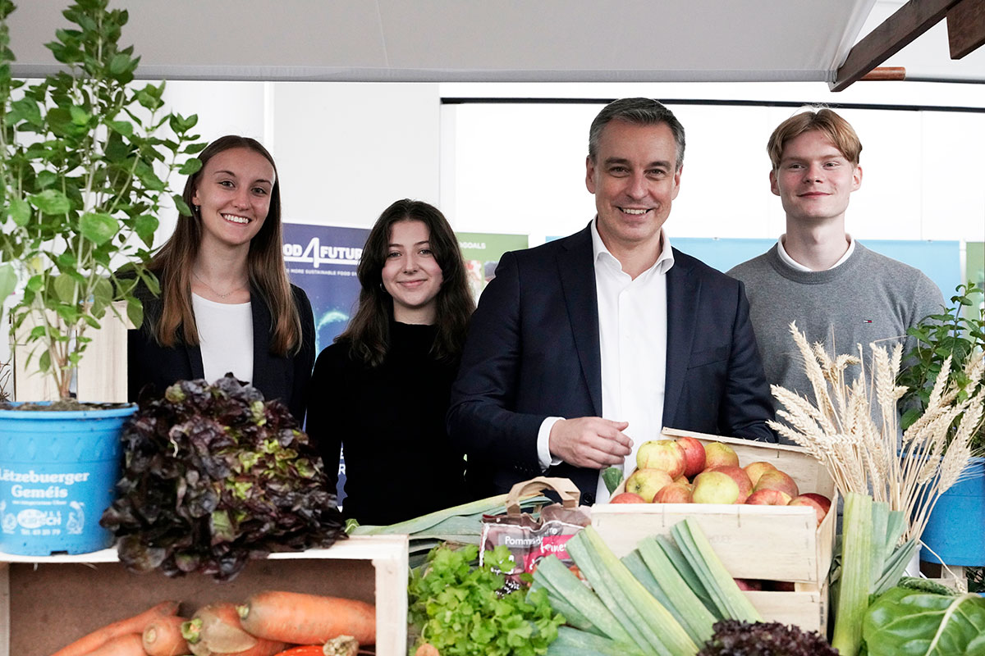
Project 4 – Meatless Monday

Slide 9
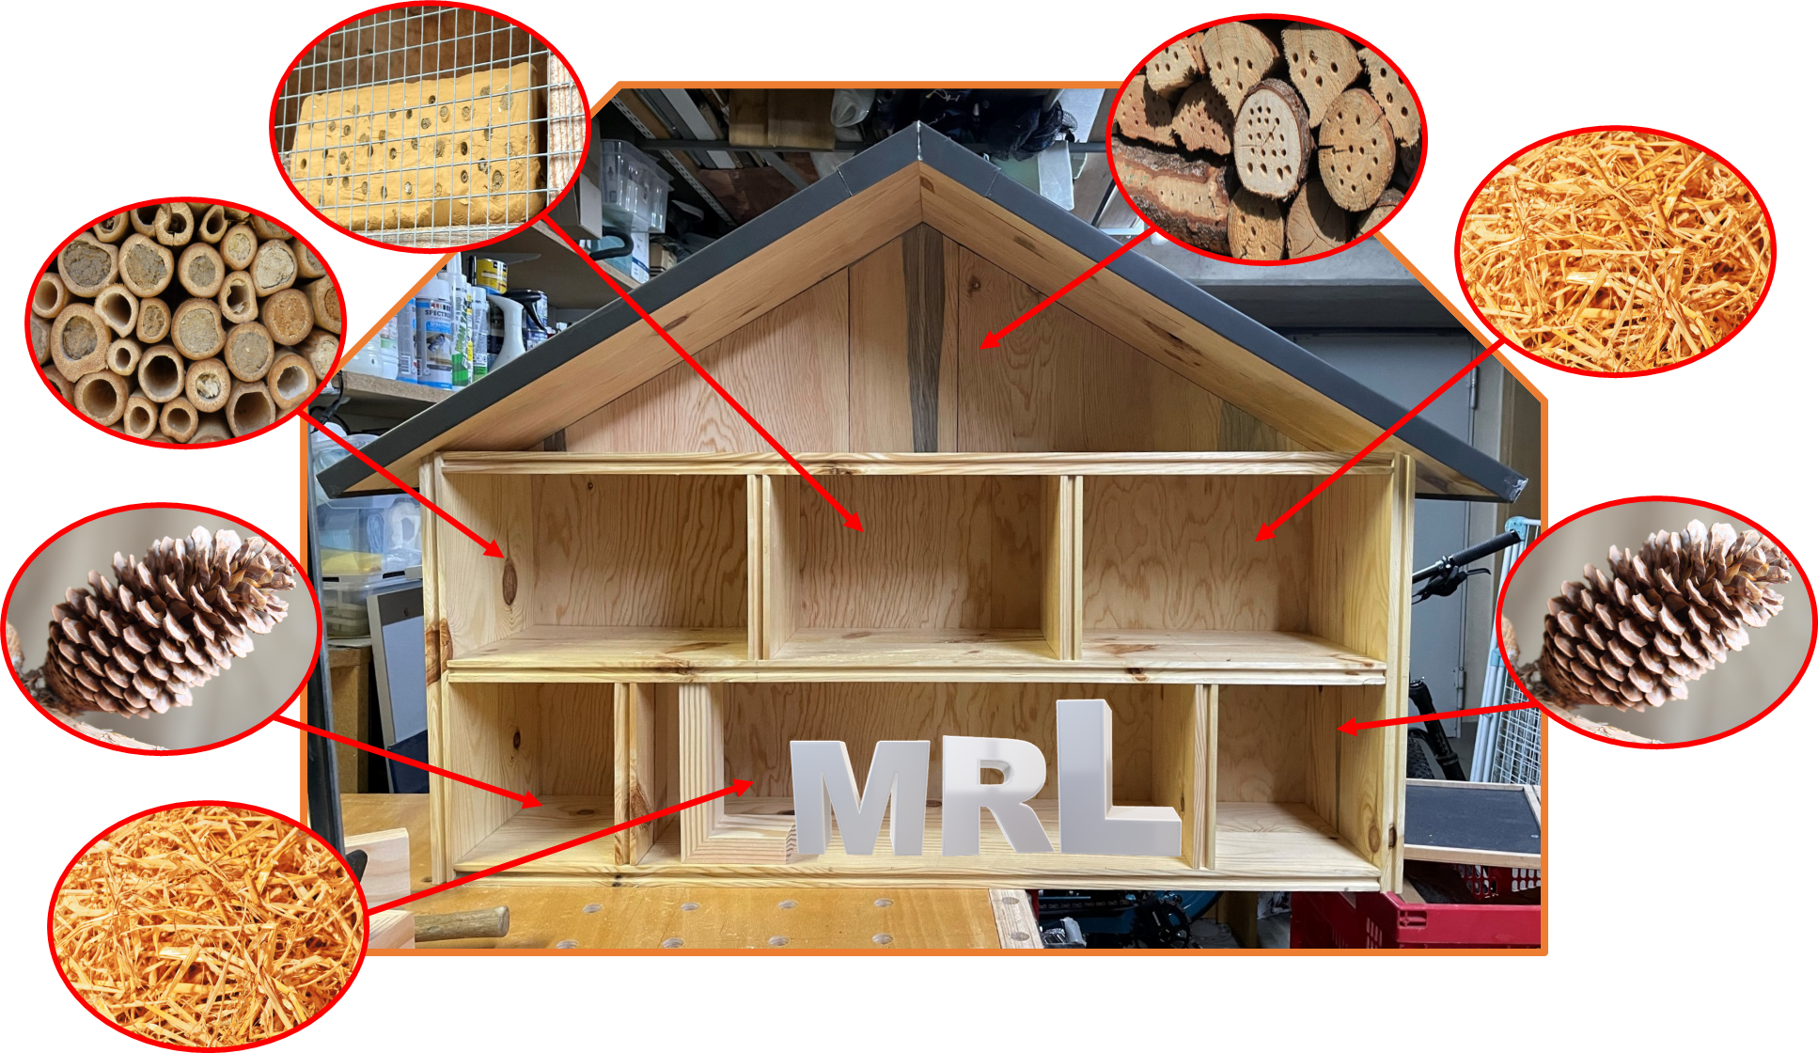
Project 5 – Insect Hotels at different schools
Bug hotels will provide a great place for insects to live, lay their eggs and hibernate.
Biodiversity
Urban biotope for insects
Supports ecological balance
Good for pollinators

Slide 10
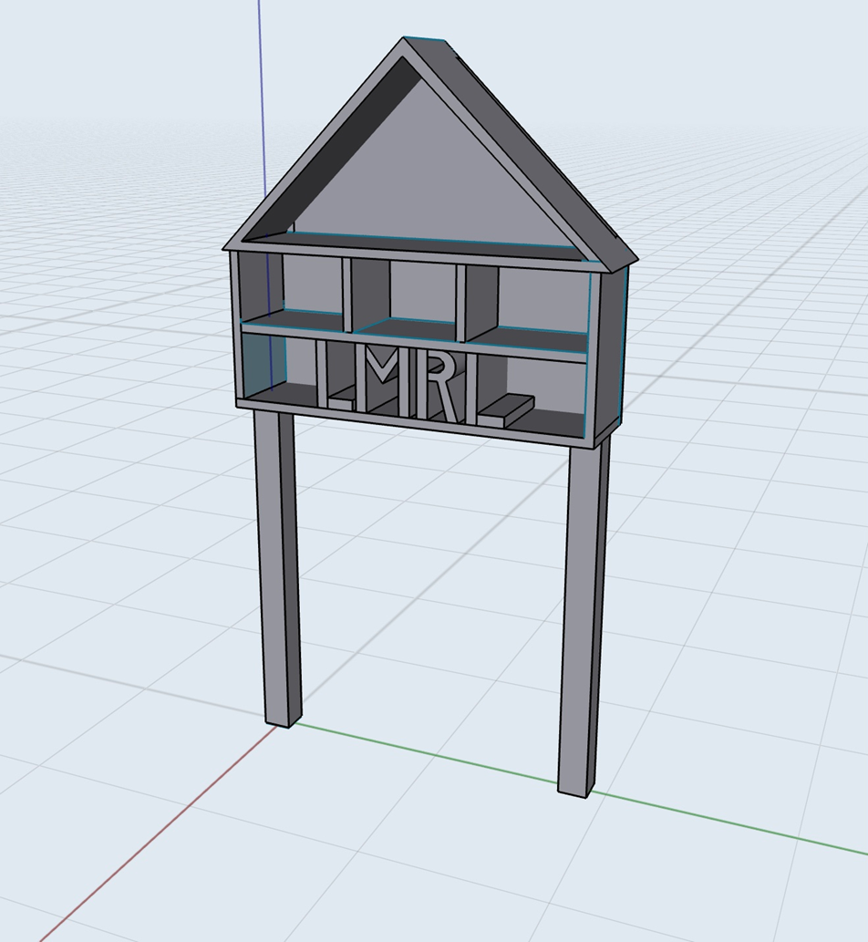
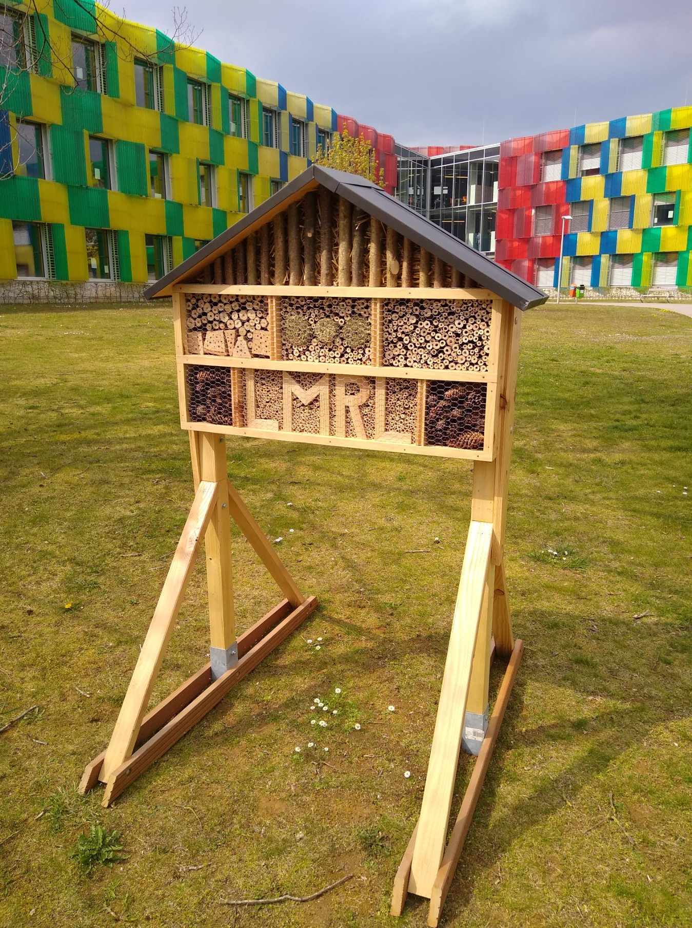
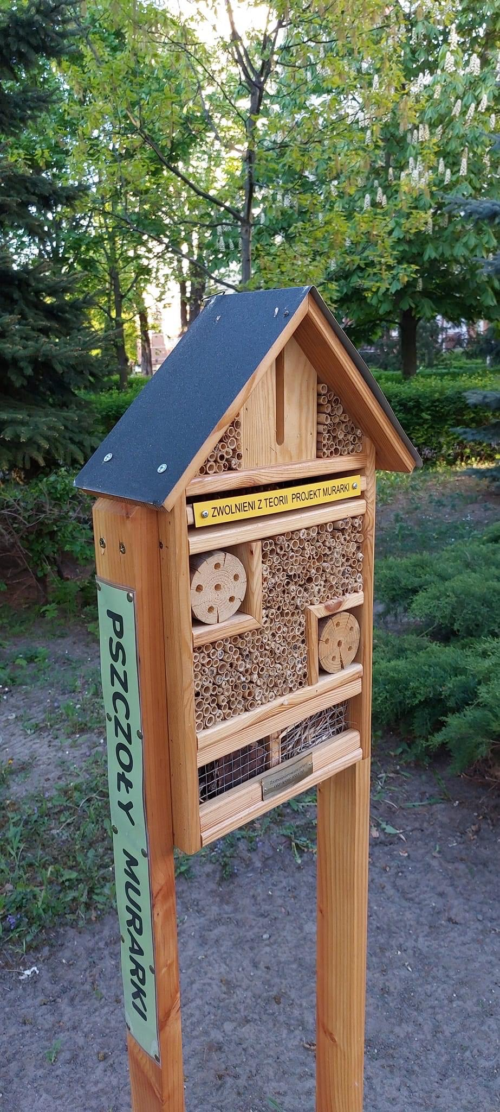
Project 5 – Insect Hotels
From concept to realisation

Slide 11

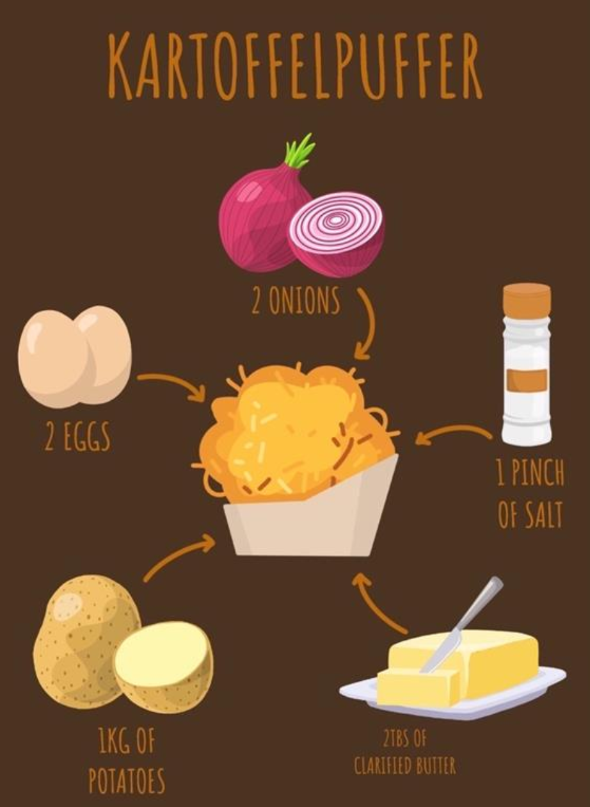
Project 6 – Veggie Cookbook
Veggie Cookbook
Promote vegetarian or vegan recipes
Motivate the school community to try meatless recipes
Positive encouragement rather than vilification
Fun project for students and easy to realize

Slide 12

Project 6 – Veggie Cookbook

Slide 13
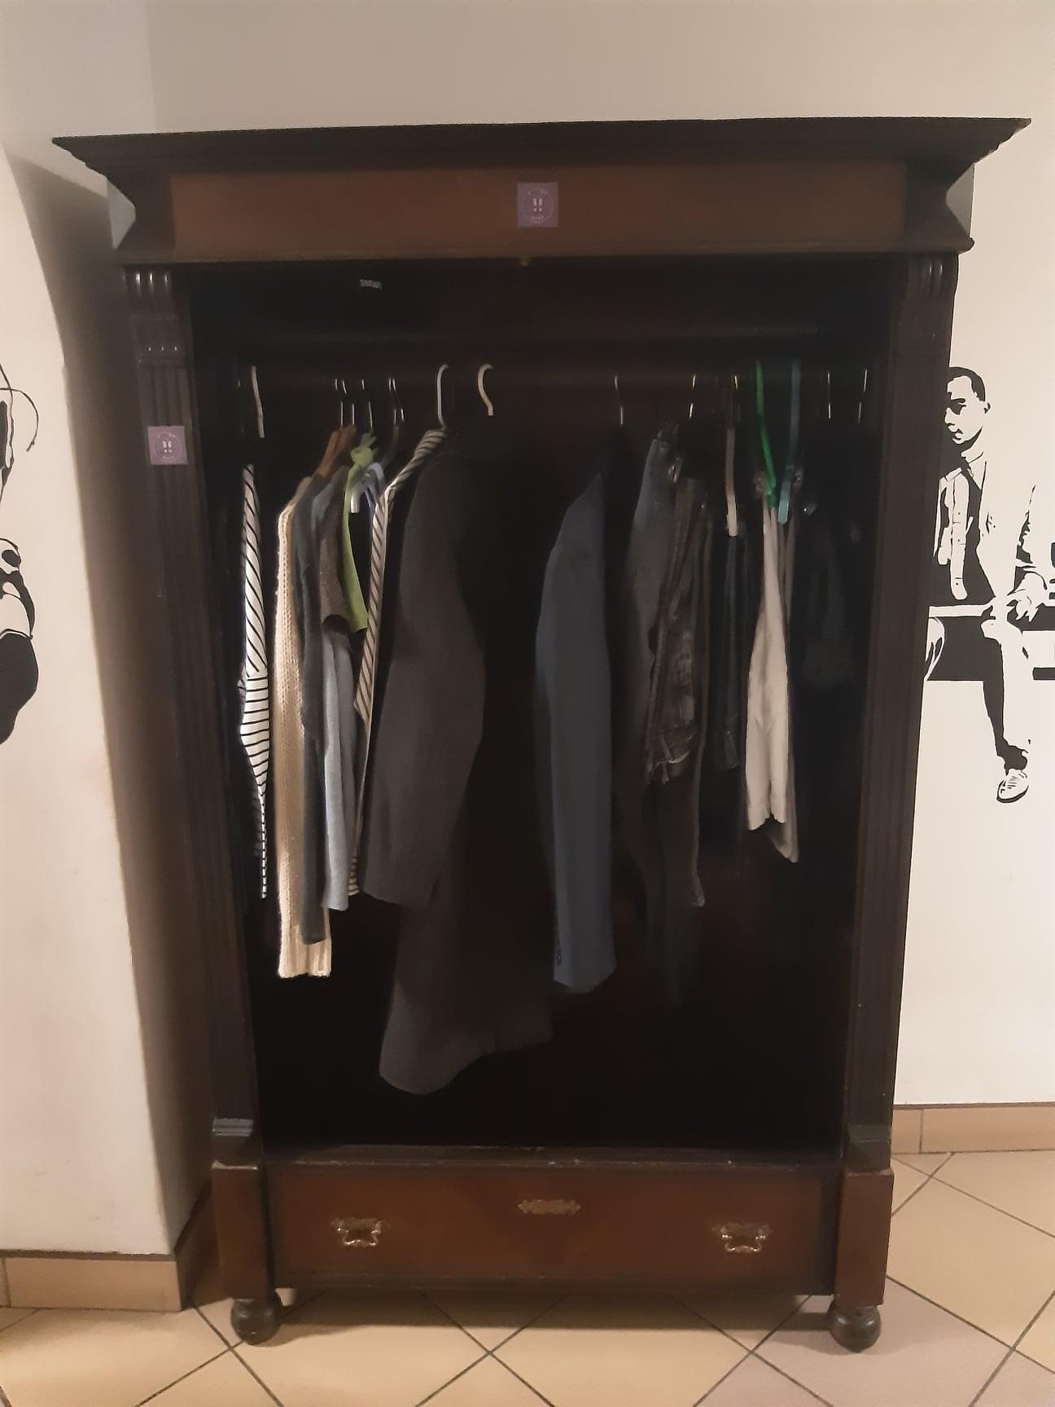

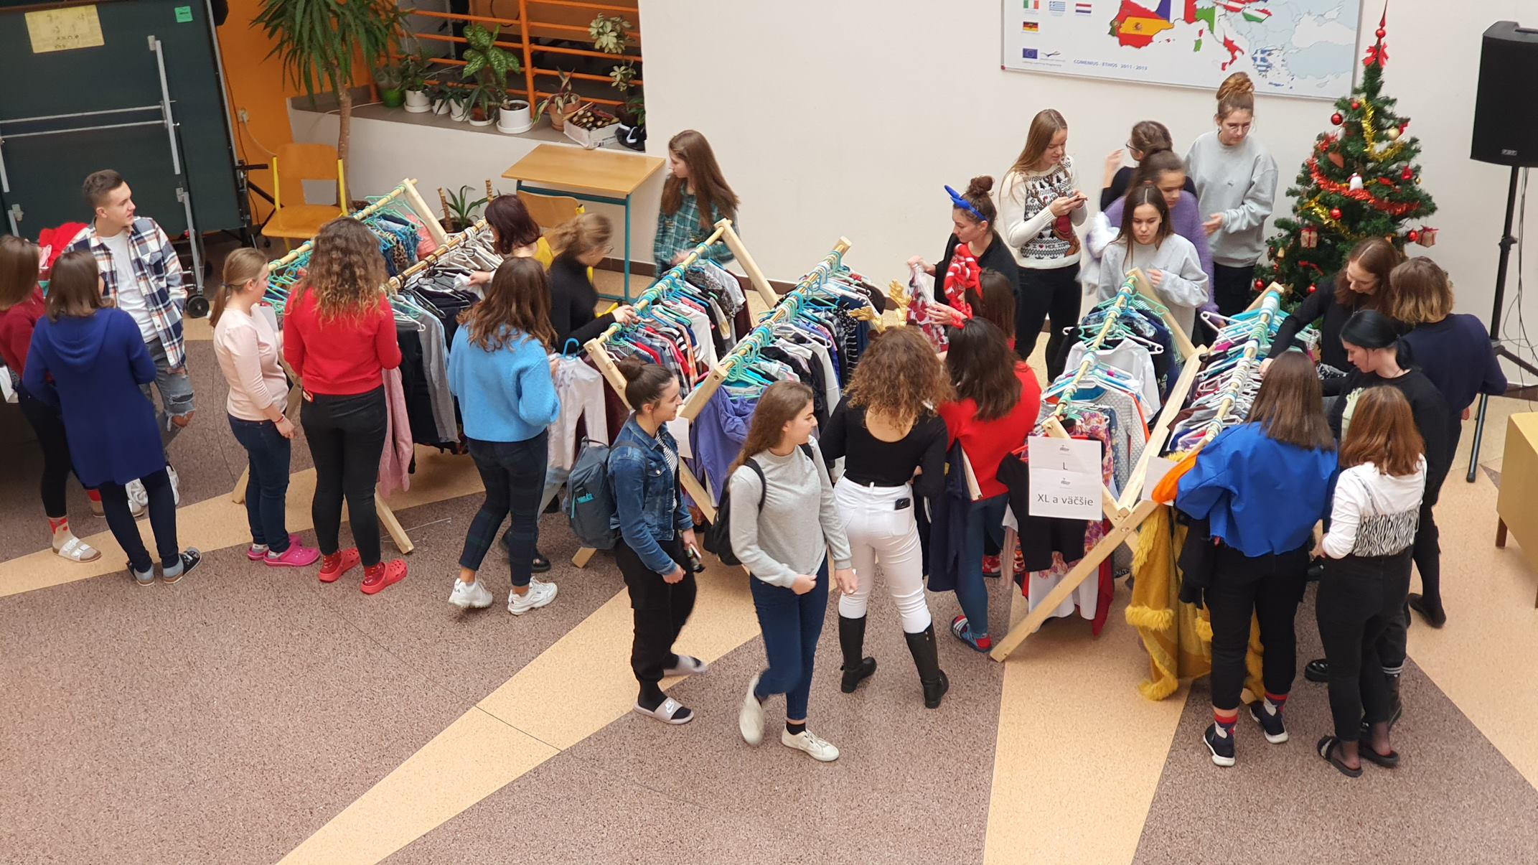
More examples: Slovakia & Poland
Club members organised a big school swap, where students brought clothes they hardly ever used and shared them with others (more than 300 pieces were used again).
CLOTHES SWAP („reuse“)

Slide 14
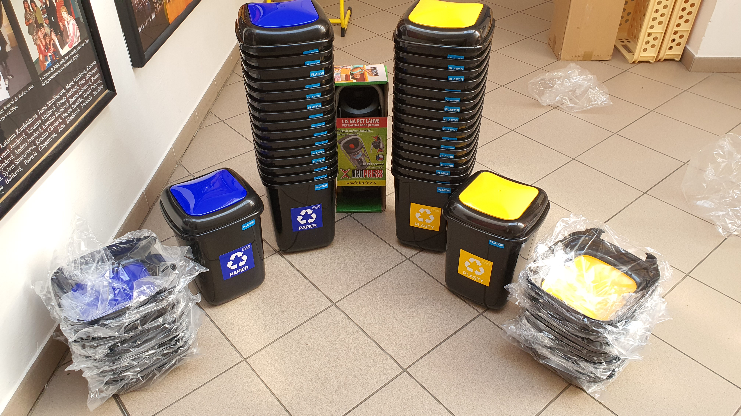
More best practices
New recycling bins for every classroom

Slide 15
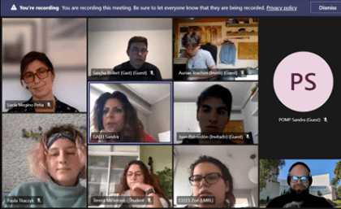
Project work during pandemic…
ONLINE meetings of the club presidents and teachers on a monthly basis, on Friday afternoon
Organisation of the meetings of presidents, where they could share recent experience, planned activities and inspire each other.

Slide 16
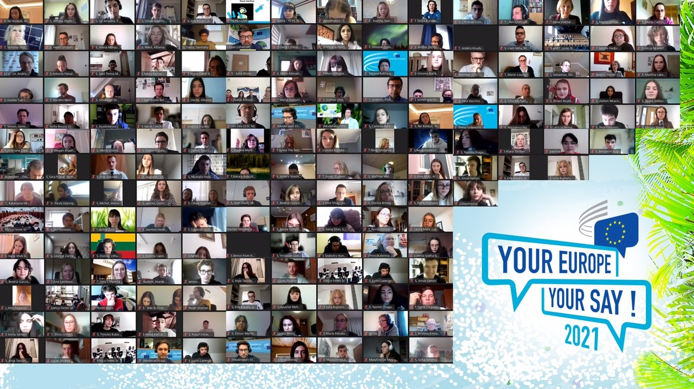
Project work during pandemic…
ONLINE conference: YEYS 2021
European Climate Conference
“Our Climate Our Future”
organised by European Economic and Social Committee

Slide 17
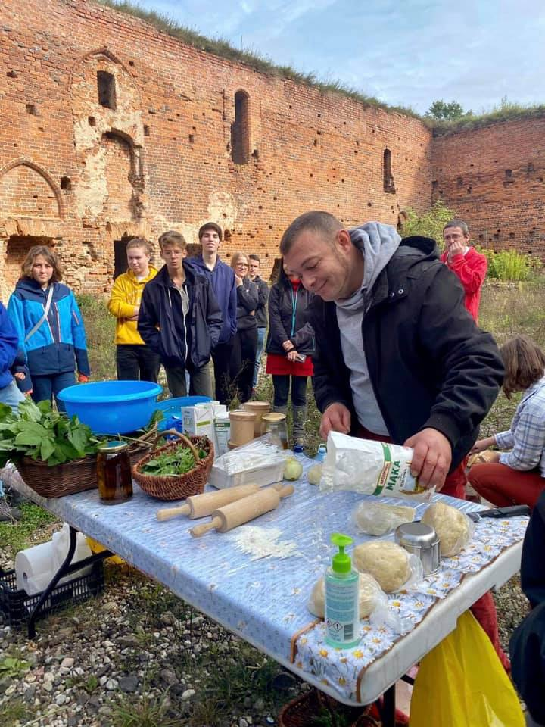
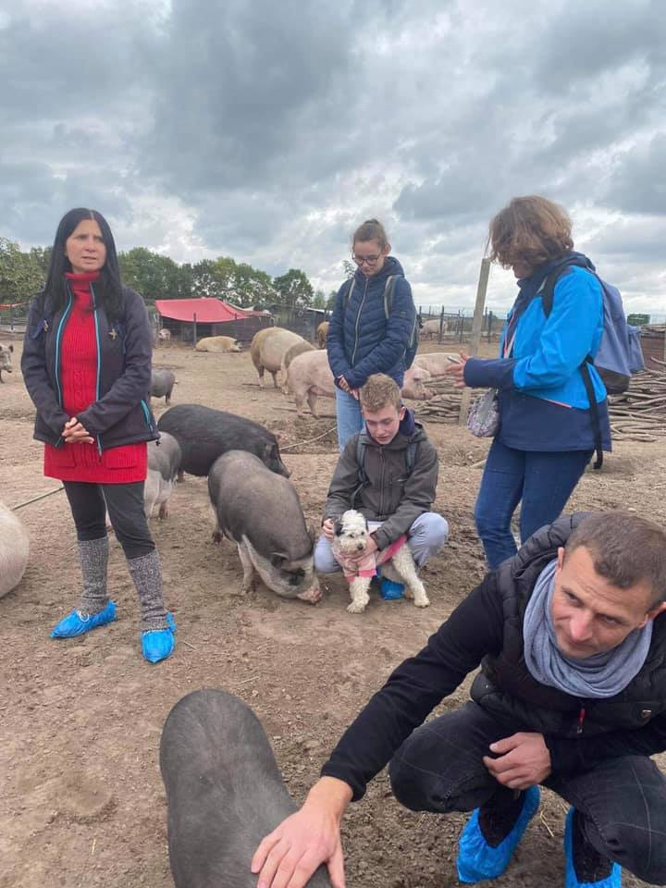

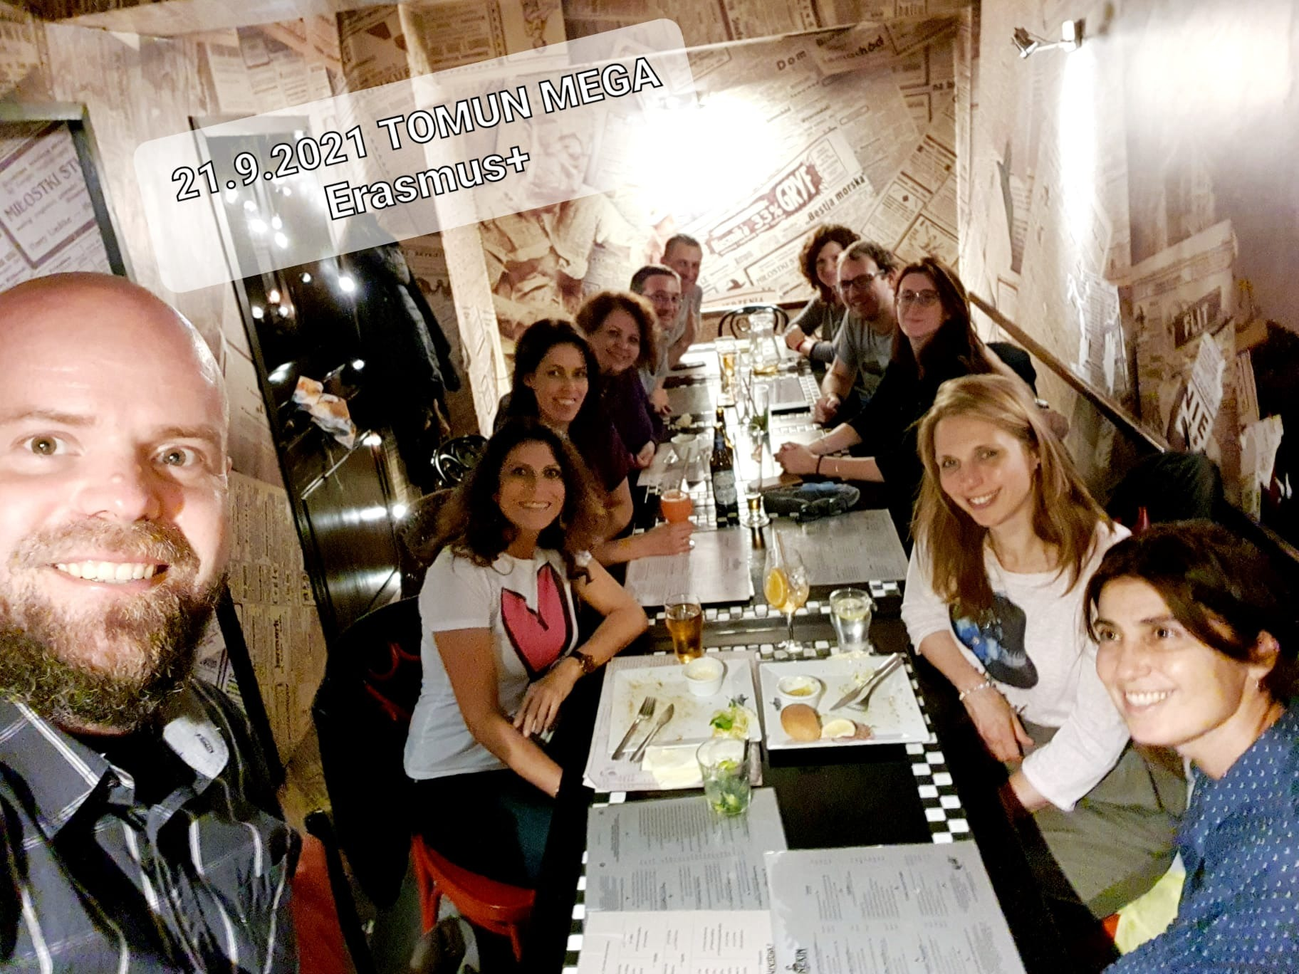
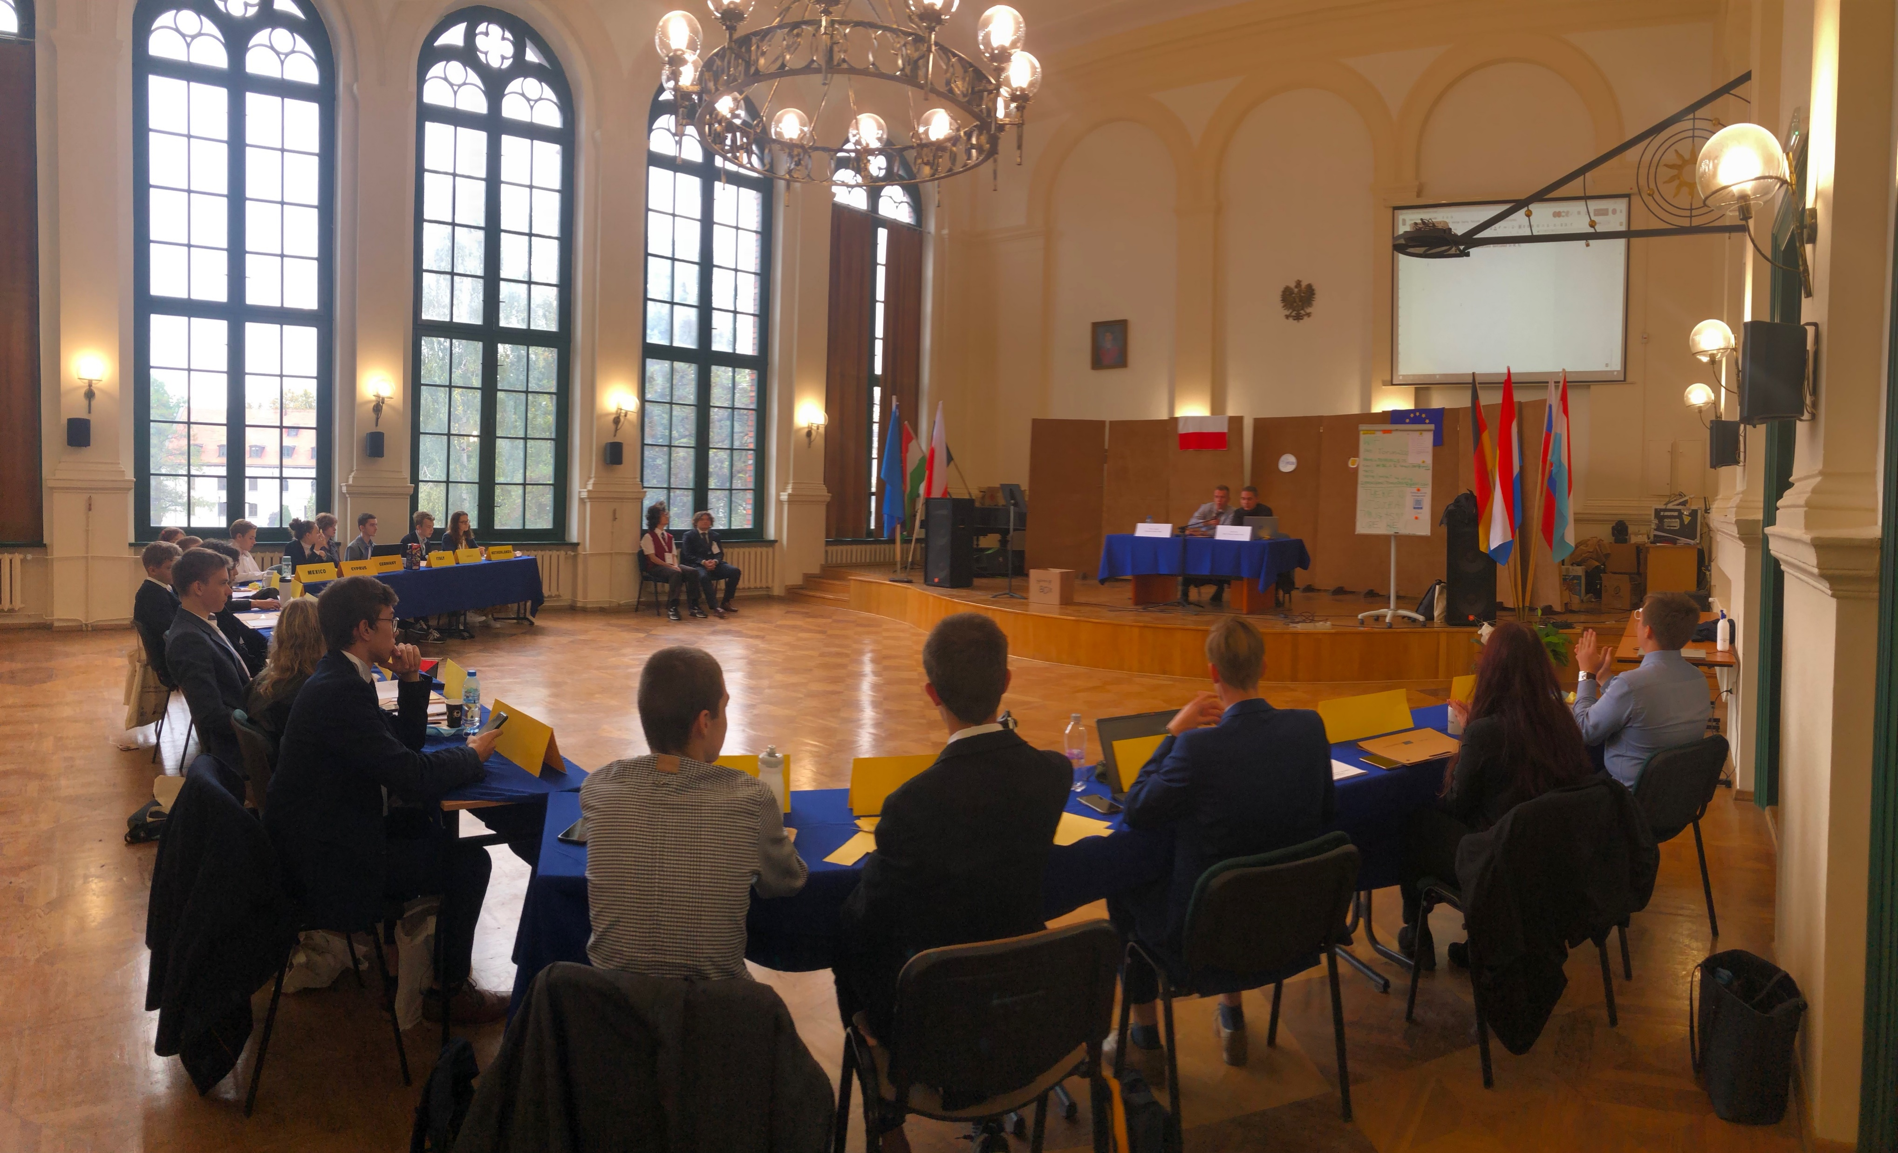
Toruň meeting – September 2021: Eco-activities & MUN

Slide 18
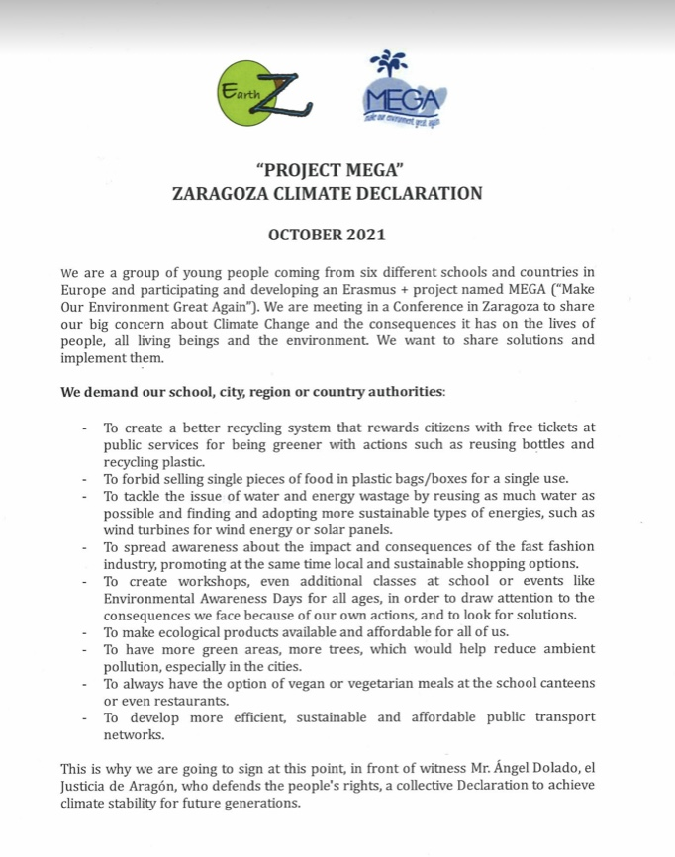
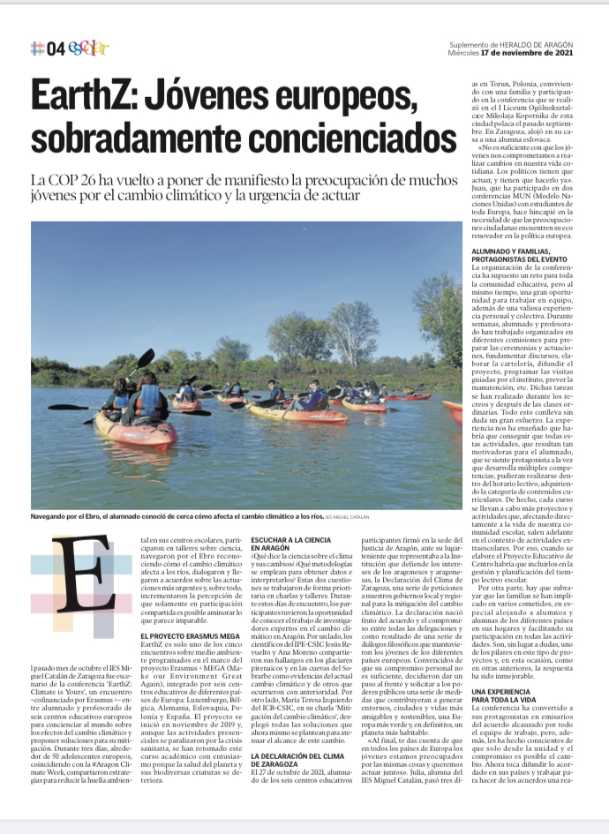
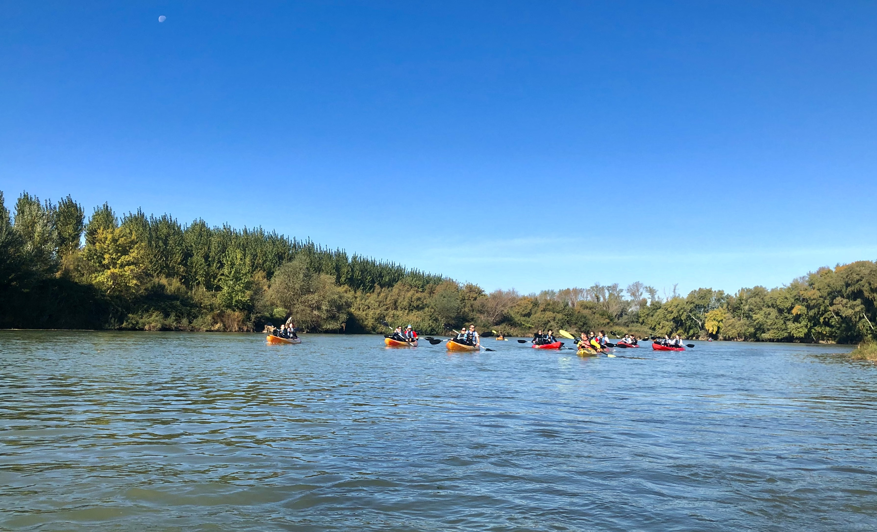
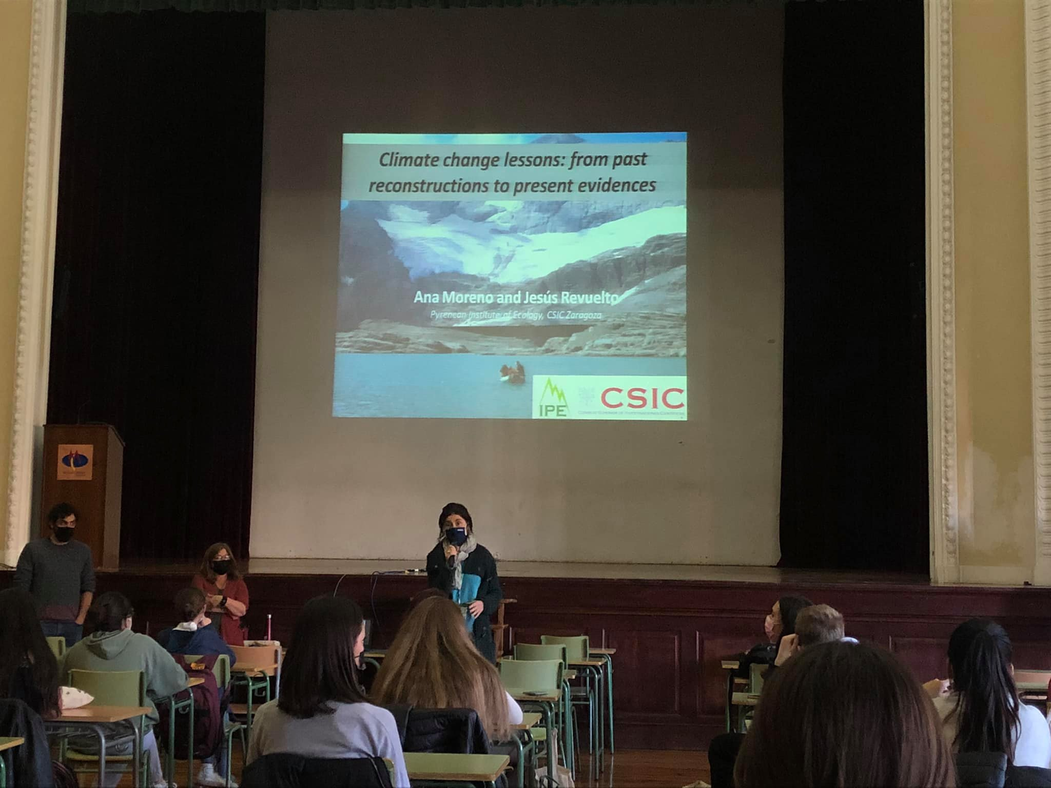
Zaragoza meeting – October 2021: Eco-activities & EarthZ

Slide 19
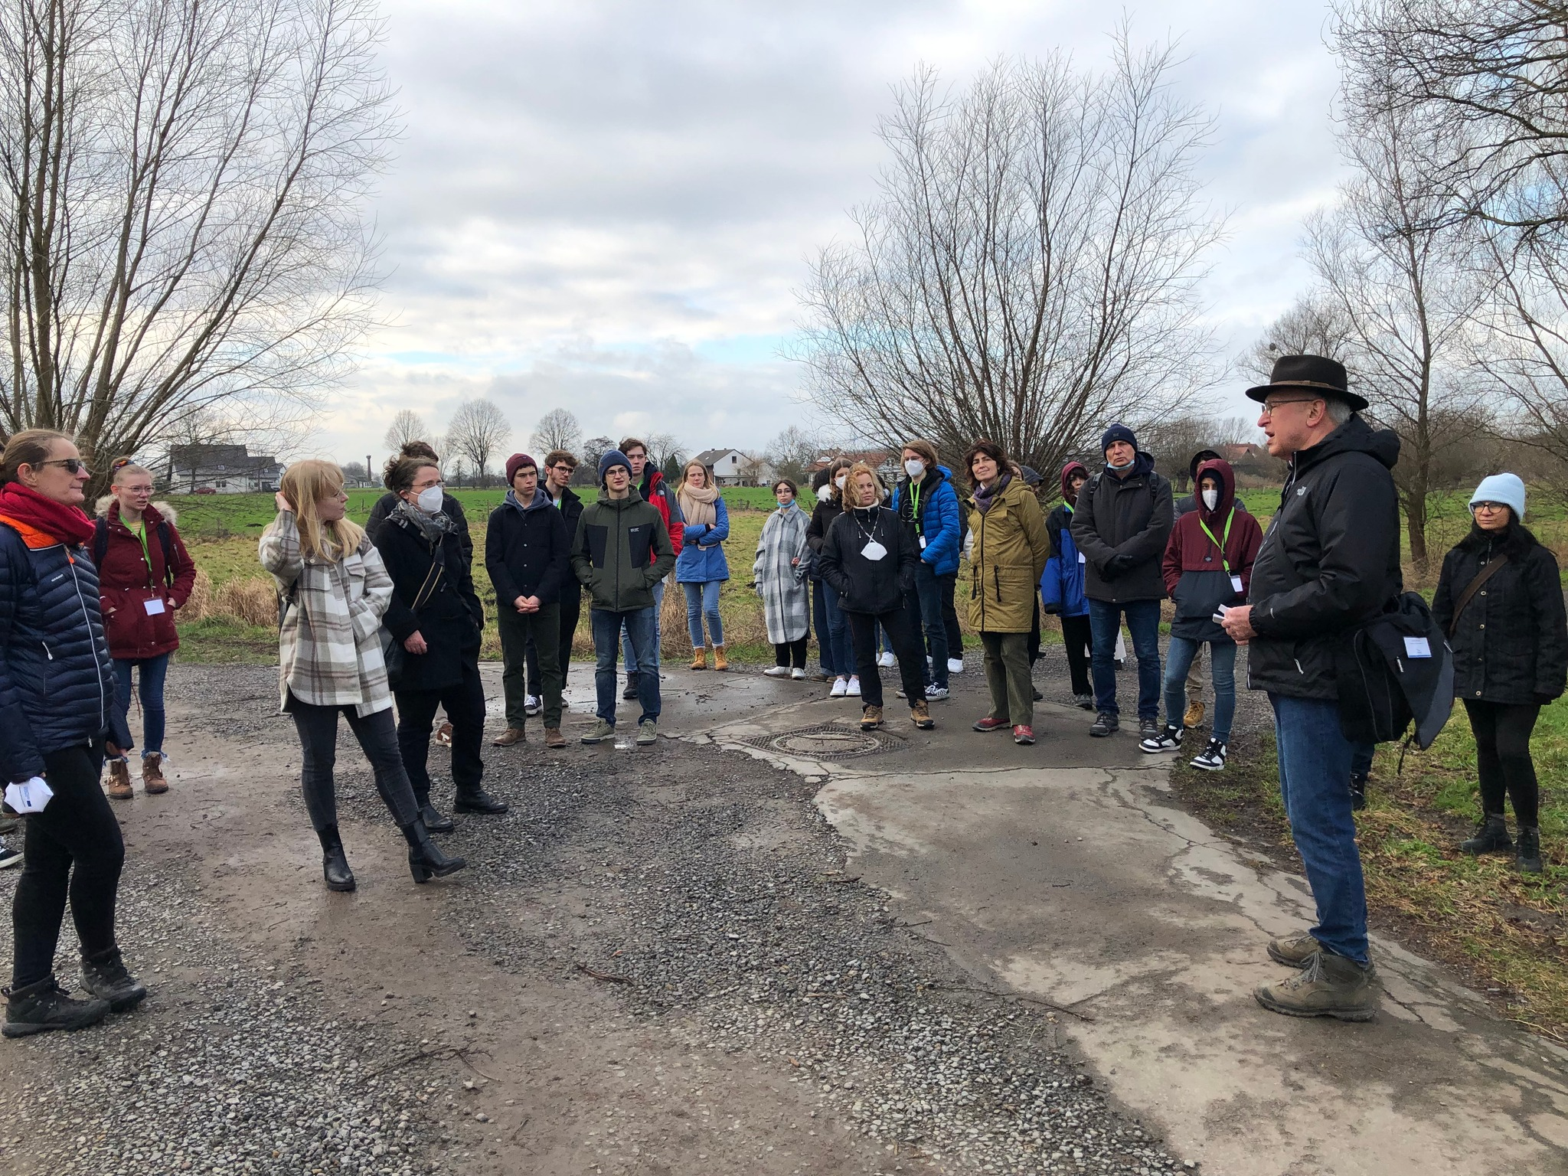
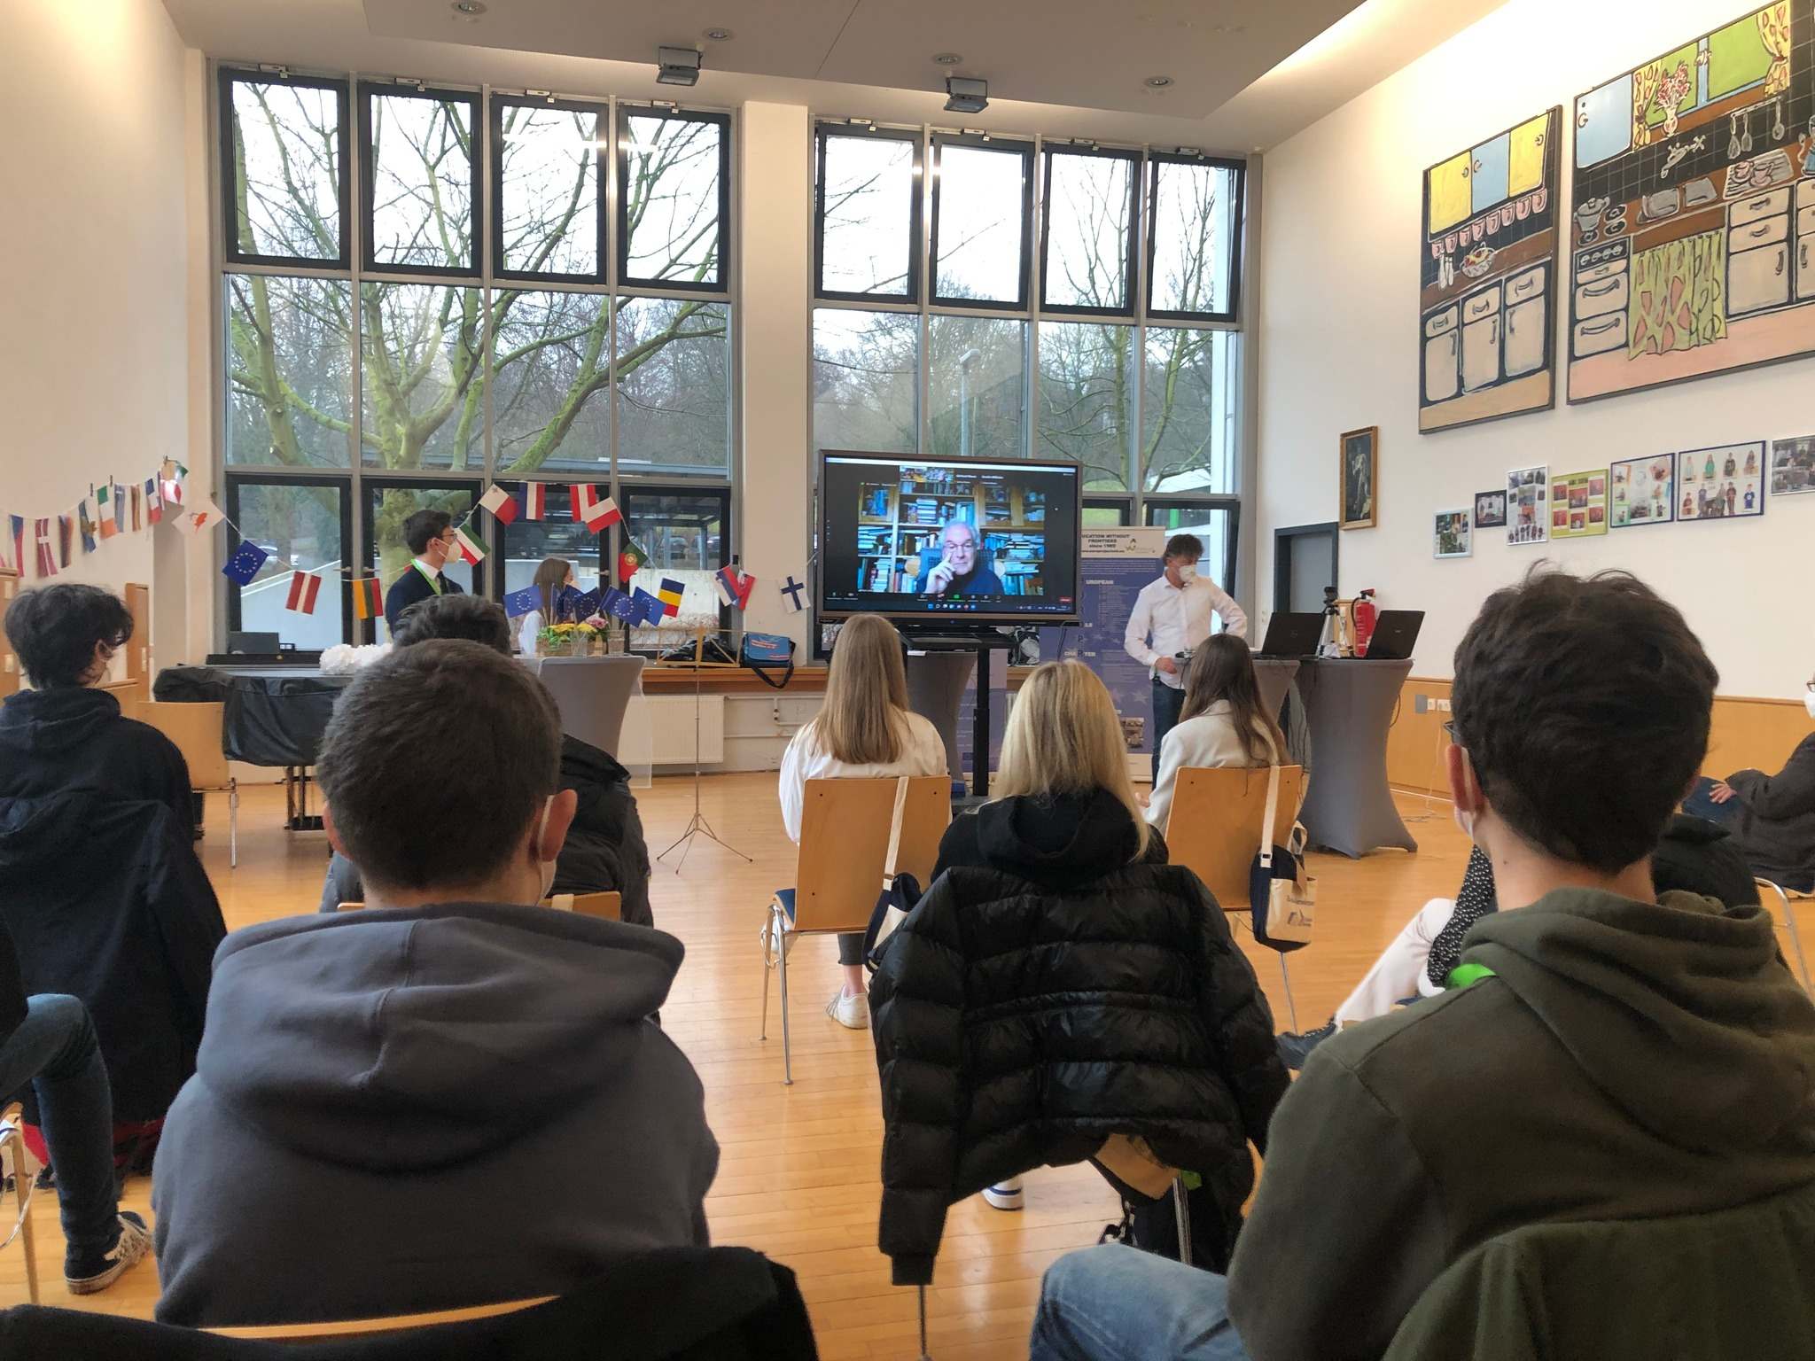
Lübbecke meeting – February 2022: Let’s Go Green

Slide 20
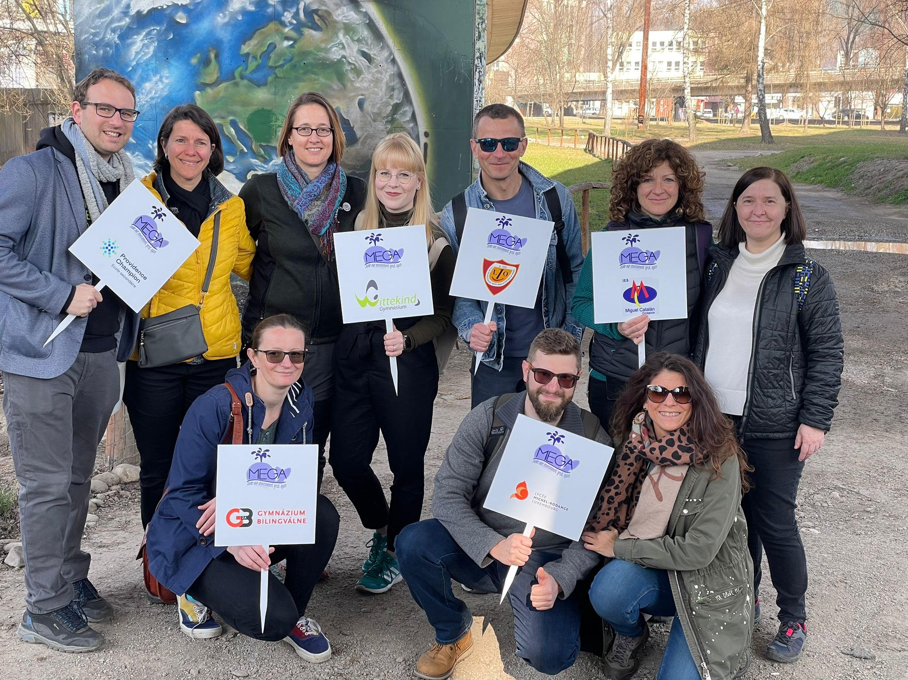
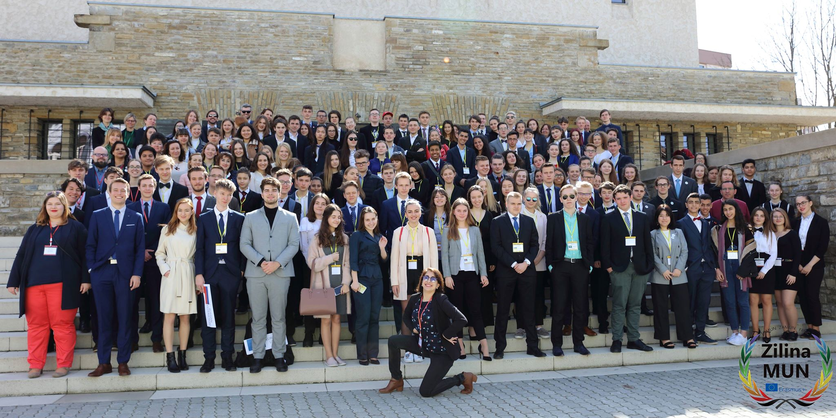
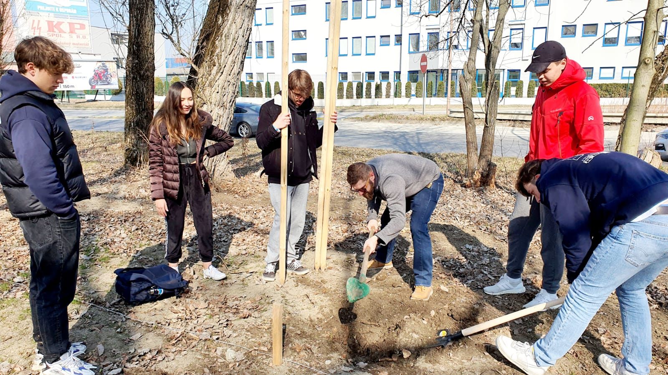
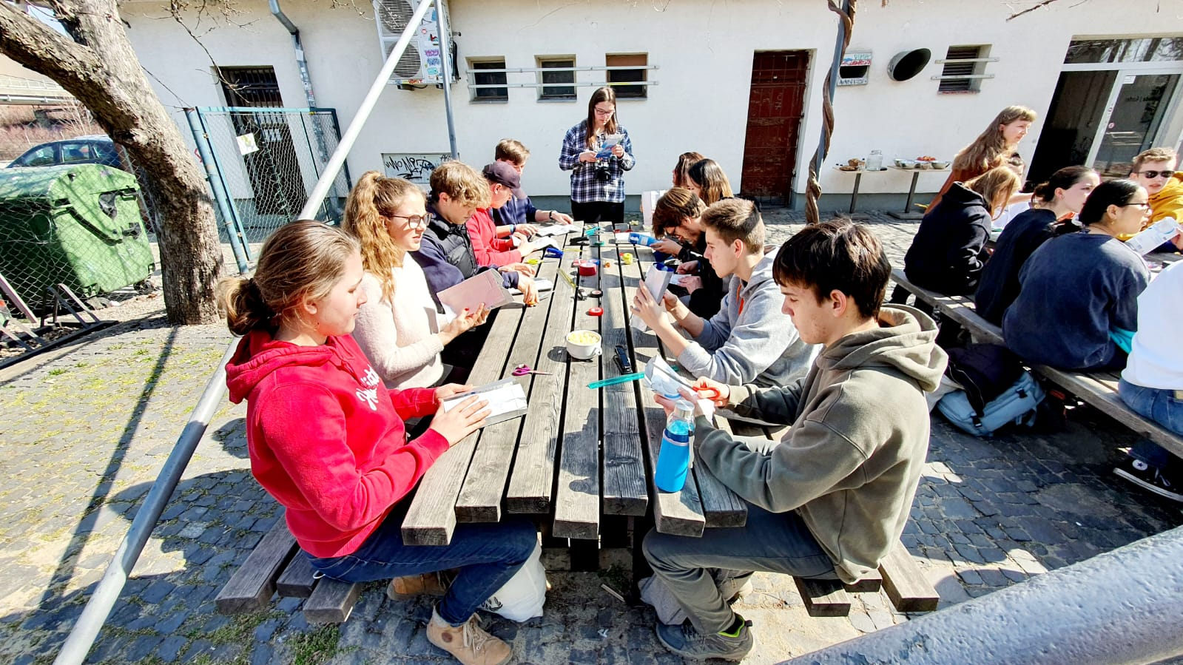
Žilina meeting – March 2022: Eco-activities & MUN

Slide 21
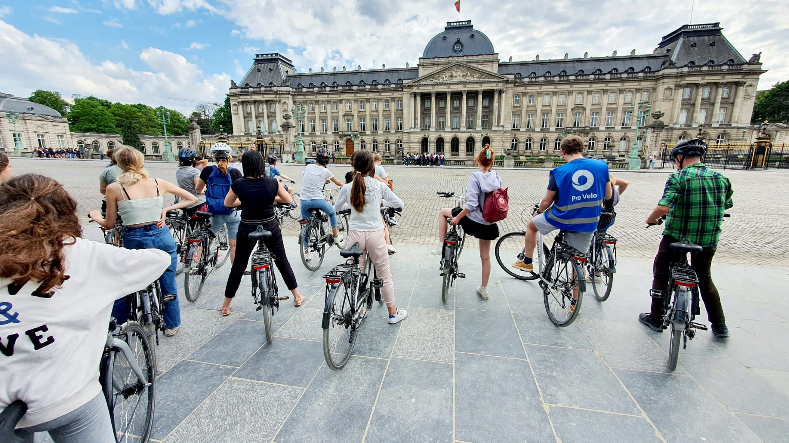
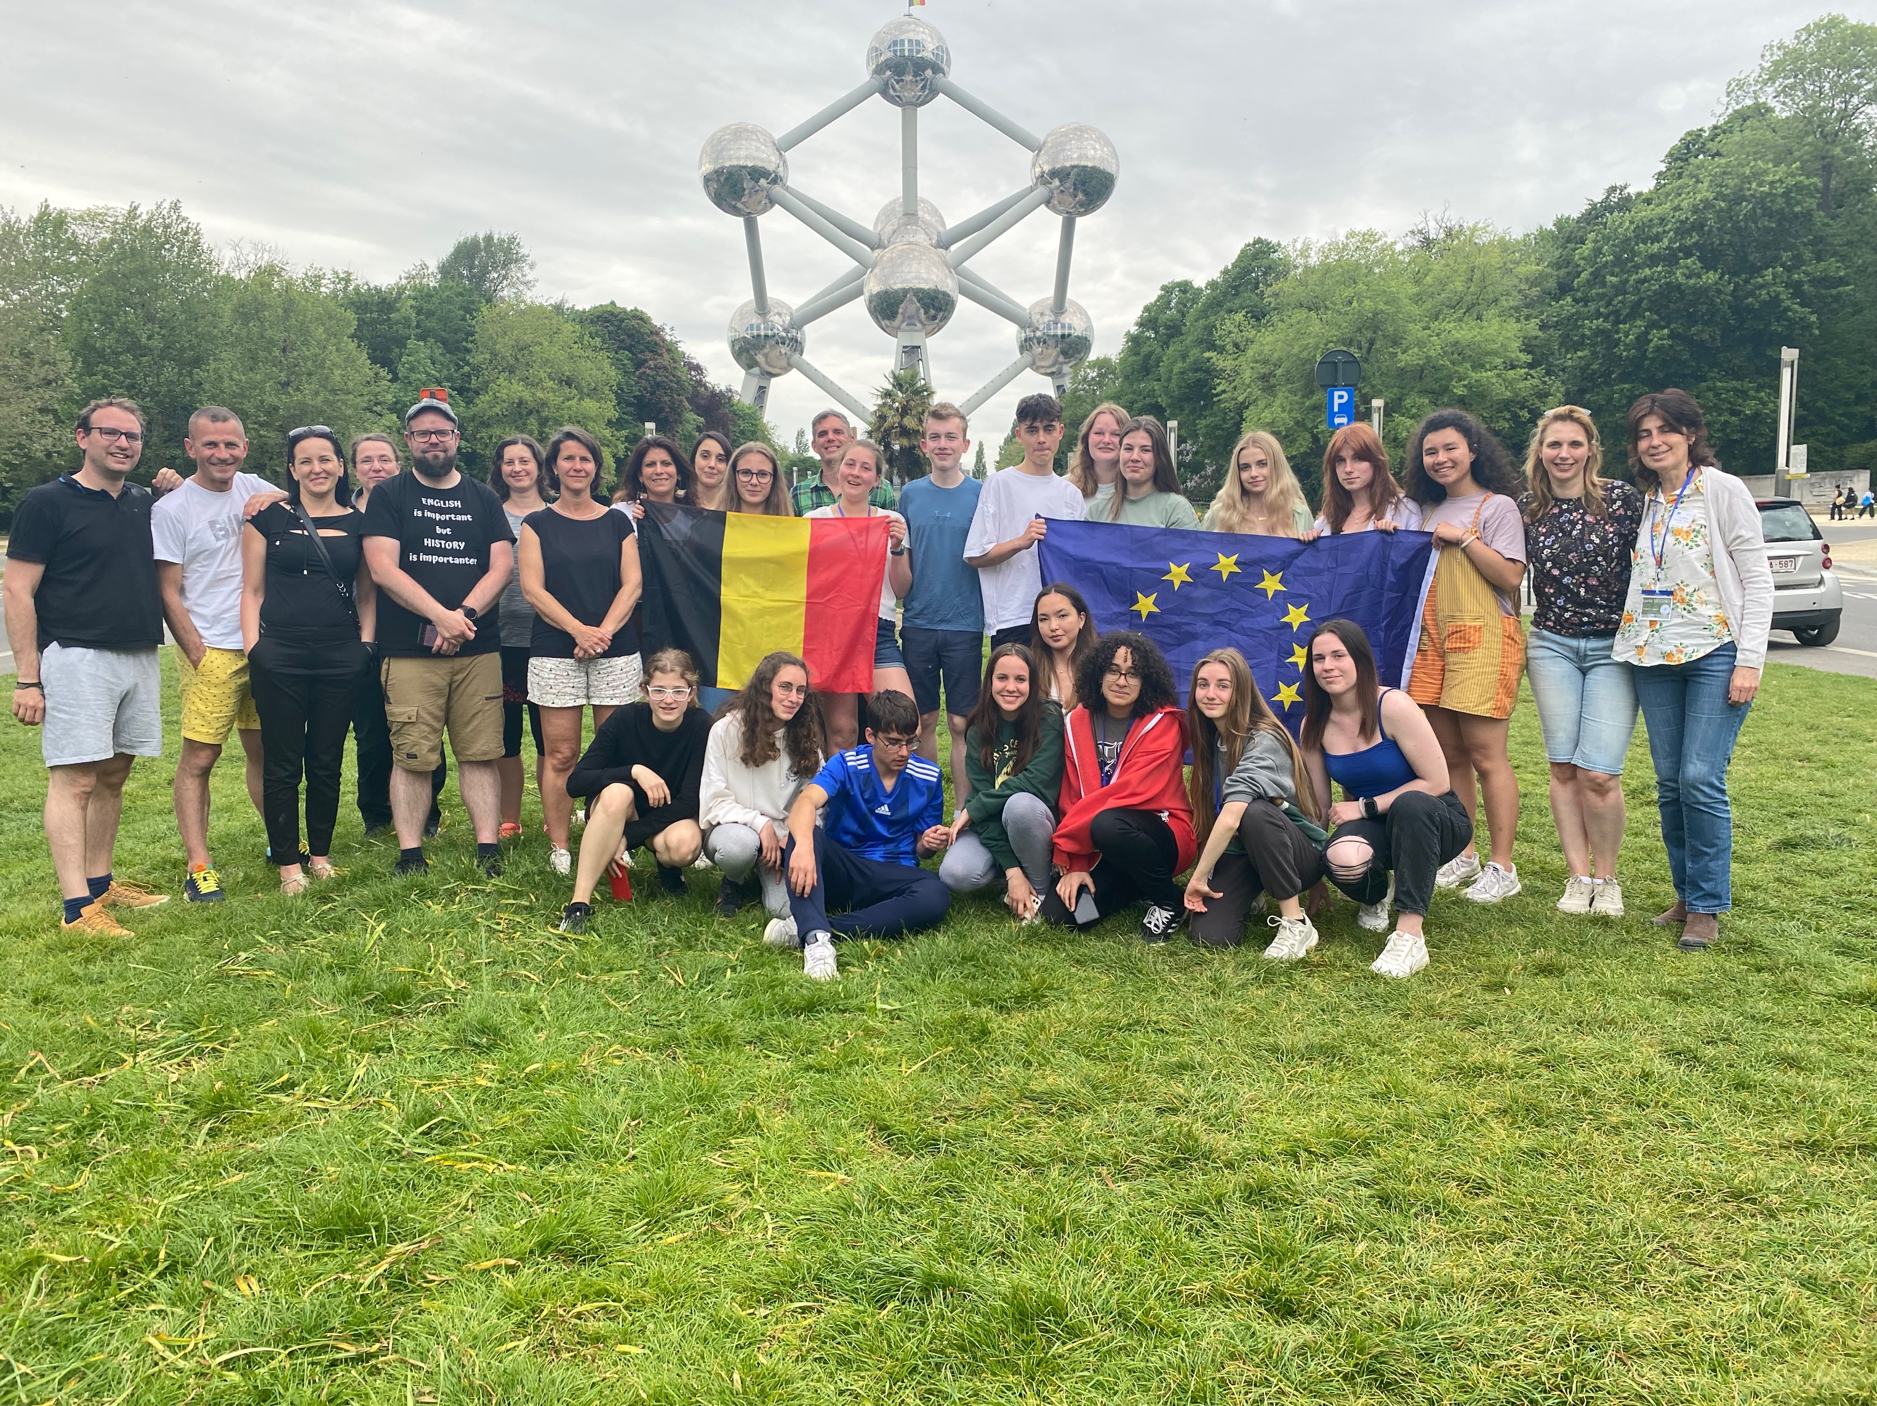
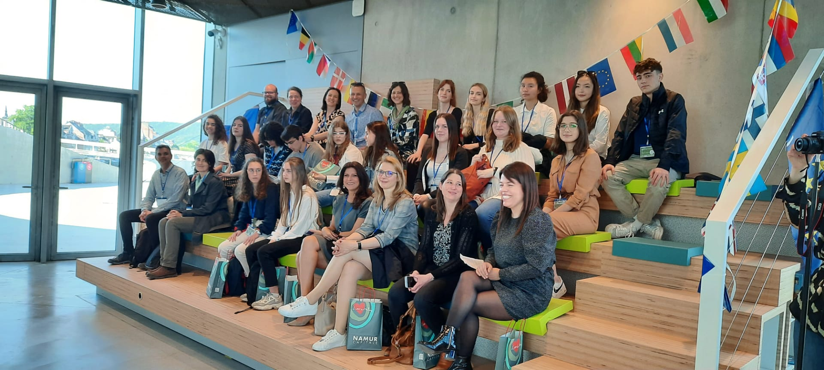
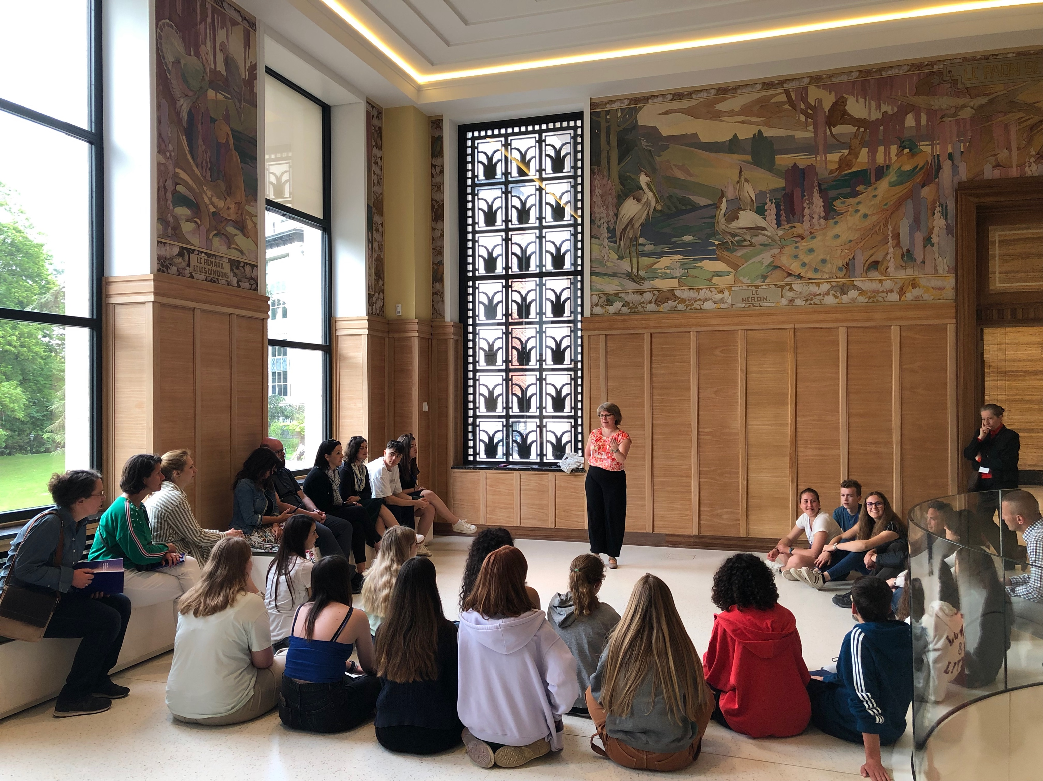
Namur meeting – May 2022

Slide 22


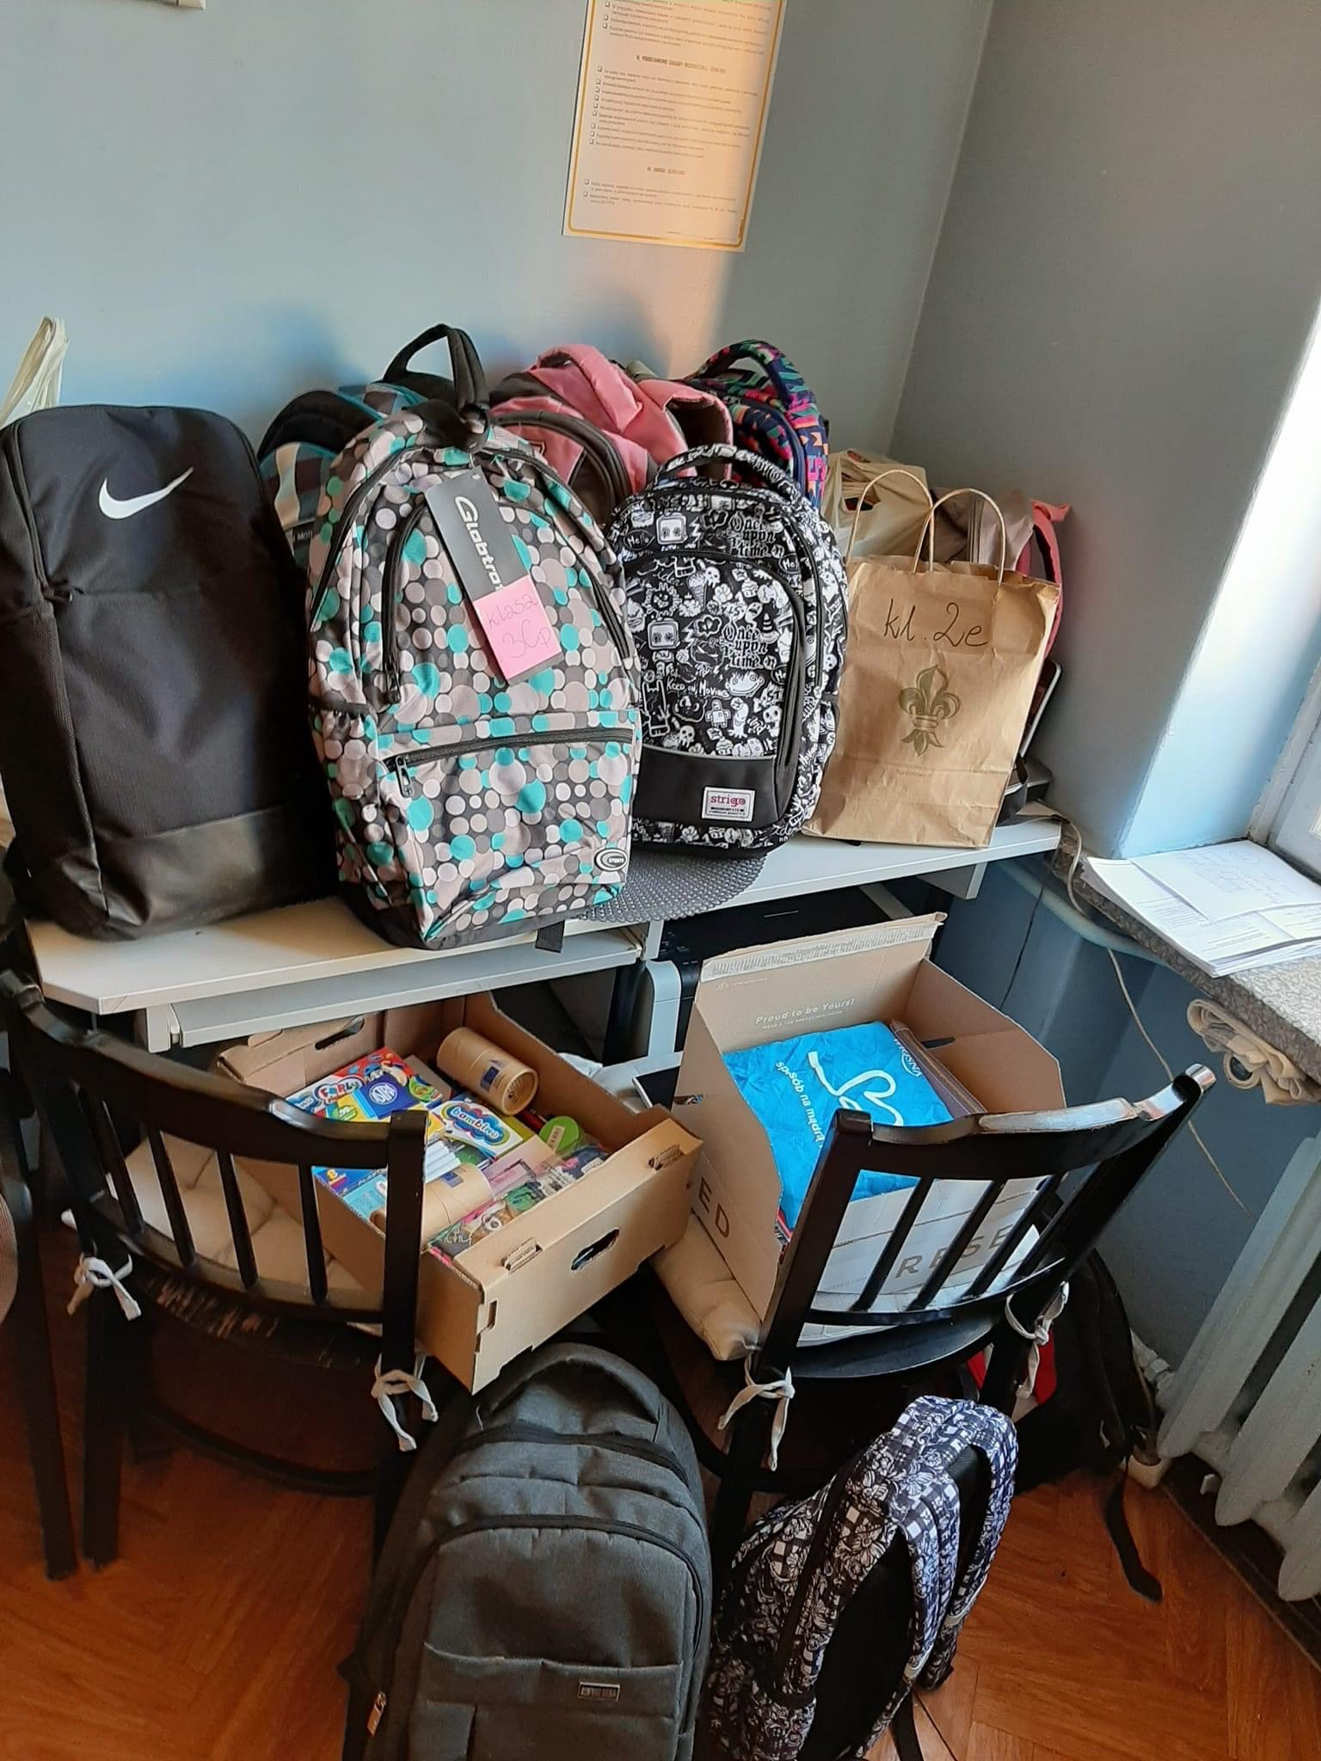
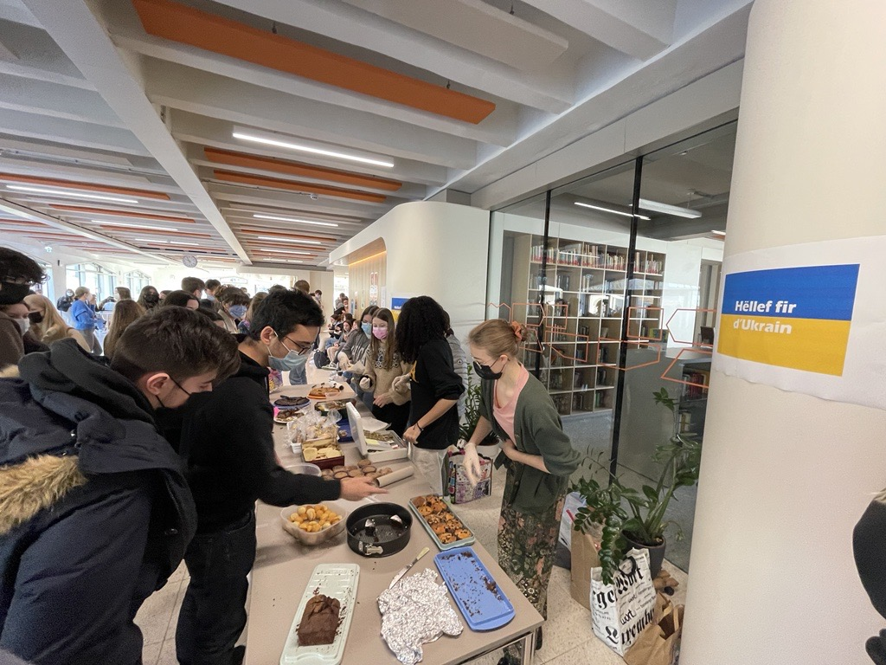
Latest activity: collecting money & backpacks for Ukraine

Slide 23
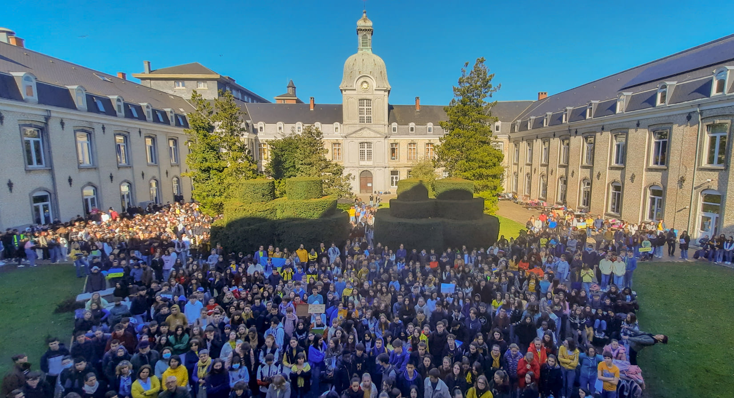
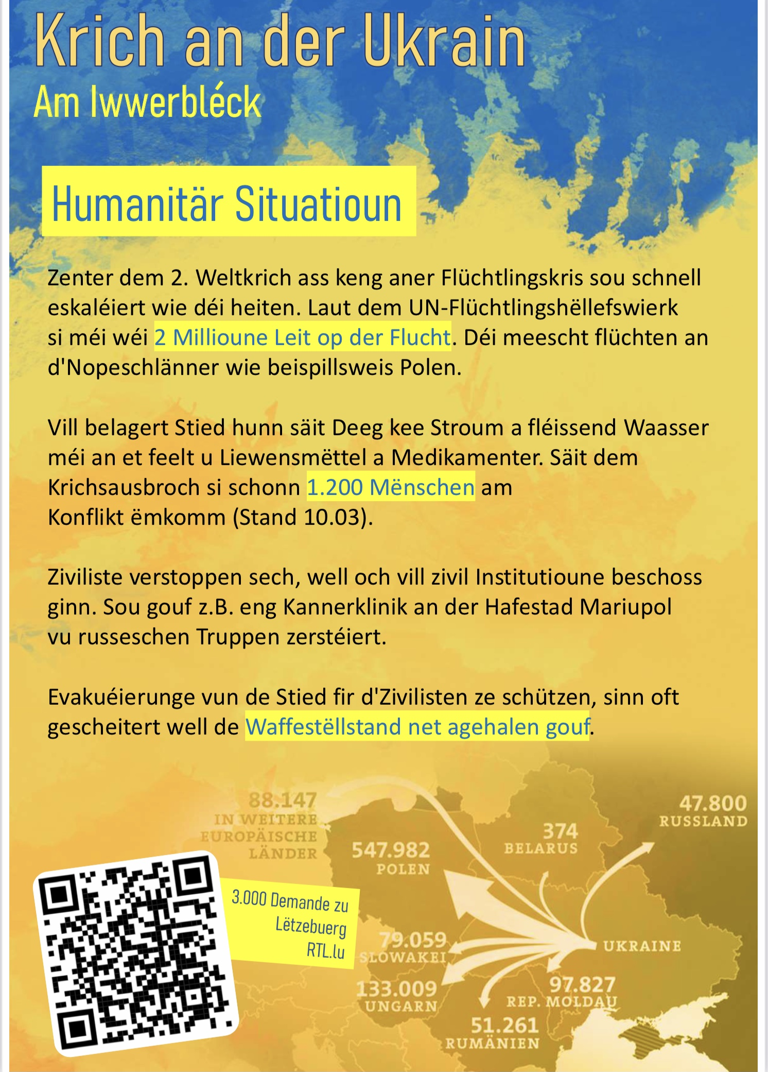
Latest activity: solidarity actions & info campaigns

Slide 24


